Slide 1
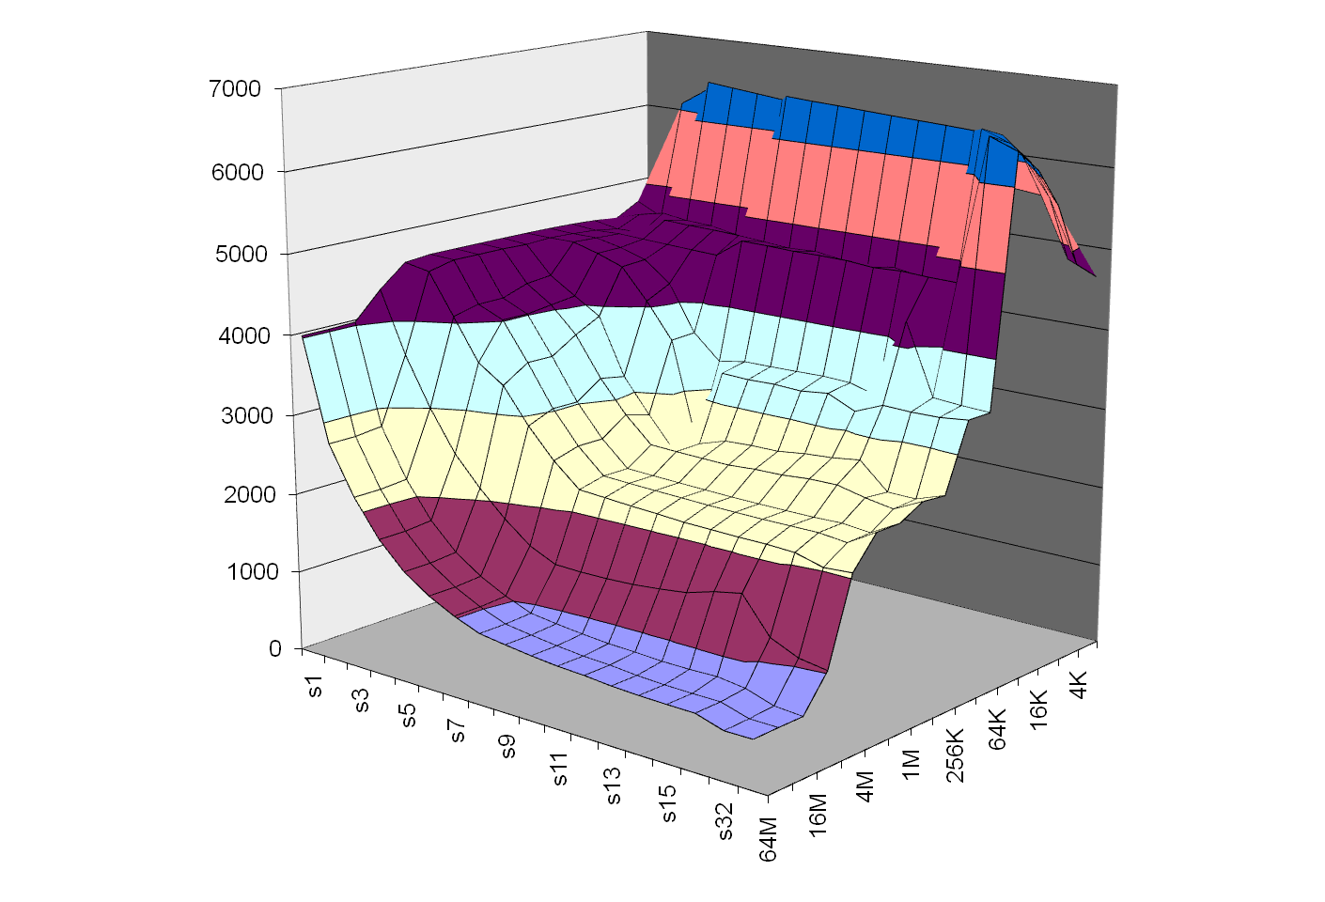
Introducing Computer Systems from a
Programmer’s Perspective
Randal E. Bryant, David R. O’Hallaron
Computer Science and Electrical Engineering
Carnegie Mellon University

Slide 2
Outline
Introduction to Computer Systems
  Course taught at CMU since Fall, 1998
  Some ideas on labs, motivations, …
Computer Systems: A Programmer’s Perspective
  Our textbook, now in its second edition
  Ways to use the book in different courses

Slide 3
Background
1995-1997: REB/DROH teaching computer architecture course at CMU.
  Good material, dedicated teachers, but students hate it
  Don’t see how it will affect their lives as programmers

Slide 4
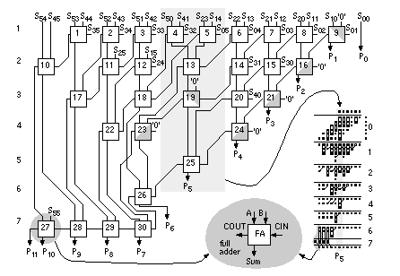
Computer Arithmetic
Builder’s Perspective
32-bit
Multiplier
  How to design high performance arithmetic circuits

Slide 5
Computer Arithmetic
Programmer’s Perspective
void show_squares()
{
int x;
for (x = 5; x <= 5000000; x*=10)
printf("x = %d x^2 = %d\n", x, x*x);
}
x = 5 x² = 25
x = 50 x² = 2500
x = 500 x² = 250000
x = 5000 x² = 25000000
x = 50000 x² = -1794967296
x = 500000 x² = 891896832
x = 5000000 x² = -1004630016
  Numbers are represented using a finite word size
  Operations can overflow when values too large
    But behavior still has clear, mathematical properties

Slide 6
Memory System
Builder’s Perspective
Builder’s Perspective
  Must make many difficult design decisions
  Complex tradeoffs and interactions between components
Direct mapped or set indexed?
Synchronous
or
asynchronous?
Write through or write back?
Main
memory
Regs
L1 d-cache
L2
unified
cache
Disk
CPU
L1 i-cache
How many lines?
Virtual or physical indexing?

Slide 7
Memory System
Programmer’s Perspective
void copyij(int src[2048][2048],
int dst[2048][2048])
{
int i,j;
for (i = 0; i < 2048; i++)
for (j = 0; j < 2048; j++)
dst[i][j] = src[i][j];
}
void copyji(int src[2048][2048],
int dst[2048][2048])
{
int i,j;
for (j = 0; j < 2048; j++)
for (i = 0; i < 2048; i++)
dst[i][j] = src[i][j];
}
5.2 ms
162 ms
(Measured on 2.7 GHz
Intel Core i7)
30 times slower!
  Hierarchical memory organization
  Performance depends on access patterns
    Including how step through multi-dimensional array

Slide 8
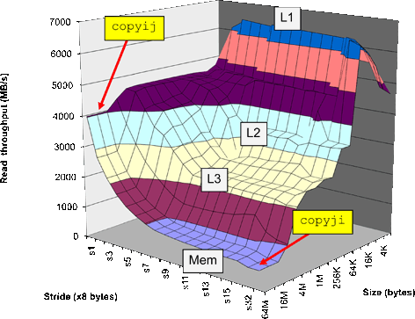
The Memory Mountain
Core i7
2.67 GHz
32 KB L1 d-cache
256 KB L2 cache
8 MB L3 cache

Slide 9
Background (Cont.)
1997: OS instructors complain about lack of preparation
  Students don’t know machine-level programming well enough
    What does it mean to store the processor state on the run-time stack?
  Our architecture course was not part of prerequisite stream

Slide 10
Birth of ICS
1997: REB/DROH pursue new idea:
  Introduce them to computer systems from a programmer's perspective rather than a system designer's perspective.
  Topic Filter: What parts of a computer system affect the correctness, performance, and utility of my C programs?
1998: Replace architecture course with new course:
  15-213: Introduction to Computer Systems
Curriculum Changes
  Sophomore level course
  Eliminated digital design & architecture as required courses for CS majors

Slide 11
15-213: Intro to Computer Systems
Goals
  Teach students to be sophisticated application programmers
  Prepare students for upper-level systems courses
Taught every semester to 400+ students
  All CS undergrads (core course)
  All ECE undergrads (core course)
  Many masters students
    To prepare them for upper-level systems courses
  Variety of others from math, physics, statistics, …
Preparation
  Optional: Introduction to CS in Python or Ruby
  Imperative programming in C subset

Slide 12
ICS Feedback
Students
Faculty
  Prerequisite for most upper level CS systems courses
  Also required for ECE embedded systems, architecture, and network courses

Slide 13
Lecture Coverage
Data representations [3]
  It’s all just bits.
  int’s are not integers and float’s are not reals.
IA32 & x86-64 machine language [5]
  Analyzing and understanding compiler-generated machine code.
Program optimization [2]
  Understanding compilers and modern processors.
Memory Hierarchy [3]
  Caches matter!
Linking [1]
  With DLL’s, linking is cool again!

Slide 14
Lecture Coverage (cont)
Exceptional Control Flow [2]
  The system includes an operating system that you must interact with.
Virtual memory [4]
  How it works, how to use it, and how to manage it.
Application level concurrency [3]
  Processes and threads
  Races, synchronization
I/O and network programming [4]
  Programs often need to talk to other programs.
Total: 27 lectures, 14 week semester

Slide 15
Labs
Key teaching insight:
  Cool Labs ⇒ Great Course
A set of 1 and 2 week labs define the course.
Guiding principles:
  Be hands on, practical, and fun.
  Be interactive, with continuous feedback from automatic graders
  Find ways to challenge the best while providing worthwhile experience for the rest
  Use healthy competition to maintain high energy.

Slide 16
Lab Exercises
Data Lab (2 weeks)
  Manipulating bits.
Bomb Lab (2 weeks)
  Defusing a binary bomb.
Buffer Lab (1 week)
  Exploiting a buffer overflow bug.
Performance Lab (2 weeks)
  Optimizing kernel functions.
Shell Lab (1 week)
  Writing your own shell with job control.
Malloc Lab (2-3 weeks)
  Writing your own malloc package.
Proxy Lab (2 weeks)
  Writing your own concurrent Web proxy.

Slide 17
Data Lab
Goal: Solve some “bit puzzles” in C using a limited set of logical and arithmetic operators.
  Examples: absval(x), greaterthan(x,y), log2(x)
Lessons:
  Information is just bits in context.
  C int’s are not the same as integers.
  C float’s are not the same as reals.
Infrastructure
  Configurable source-to-source C compiler that checks for compliance.
  Instructor can automatically select from 45 puzzles.
  Automatic testing using formal verification tools

Slide 18
Let’s Solve a Bit Puzzle!
/*
* abs - absolute value of x (except returns TMin for TMin)
* Example: abs(-1) = 1.
* Legal ops: ! ~ & ^ | + << >>
* Max ops: 10
* Rating: 4
*/
int abs(int x) {
int mask = x>>31;
return ____________________________;
}
11…1₂, = –1, x < 0
00…0₂, = 0, x ≥ 0
(x^mask)
+ 1+~mask
–x – 1, x < 0
x, x ≥ 0
+
1, x < 0
0, x ≥ 0
=
–x, x < 0
x, x ≥ 0

Slide 19
Verifying Solutions
int abs(int x) {
int mask = x>>31;
return (x ^ mask) + ~mask + 1;
}
int test_abs(int x) {
return (x < 0) ? -x : x;
}
Do these functions produce identical results?
How could you find out?

Slide 20
Bit-Level Program Model
int abs(int x) {
int mask = x>>31;
return (x ^ mask) + ~mask + 1;
}
x₀
abs
y₀
x₀
x₁
y₁
x₁
x₂
y₂
x₂
•
•
•
•
•
•
•
•
•
abs_{i}
•
•
•
•
•
•
•
•
•
y_{i}
x₃₁
y₃₁
x₃₁
  View computer word as 32 separate bit values
  Each output becomes Boolean function of inputs

Slide 21
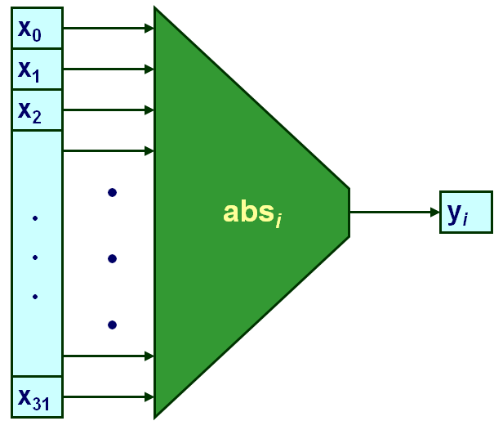
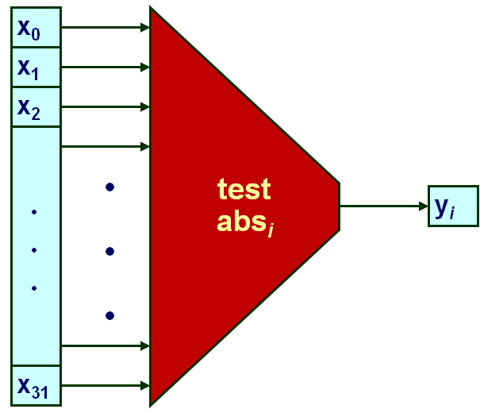
Bit-Level Program Verification
  Determine whether functions equivalent for all outputs j
  Exhaustive checking:
    Single input:
    Two input: 2⁶⁴ cases ➔ 8,800 years!
  Other approaches
    BDDs, SAT solvers
    Easily handle these functions (< 1.0 seconds)
2³² cases X 50 cycles
2 X 10⁹ cycles / second
≈ 60 seconds

Slide 22
Verification Example
int iabs(int x) {
if (x == 1234567) x++;
int mask = x>>31;
return (x ^ mask) + ~mask + 1;
}
Almost Correct
  Valid for all but one input value
  Overlooked by our test suite

Slide 23
Counterexample Generation
int iabs(int x) {
if (x == 1234567) x++;
int mask = x>>31;
return (x ^ mask) + ~mask + 1;
}
Detected By Checking Code
  Since covers all cases
  Generate counterexample to demonstrate problem
int main()
{
int val1 = iabs(1234567);
int val2 = test_iabs(1234567);
printf("iabs(1234567) --> %d [0x%x]\n", val1, val1);
printf("test_iabs(1234567) --> %d [0x%x]\n", val2, val2);
if (val1 == val2) {
printf(".. False negative\n");
} else
printf(".. A genuine counterexample\n");
}

Slide 24
Bomb Lab
  Idea due to Chris Colohan, TA during inaugural offering
Bomb: C program with six phases.
Each phase expects student to type a specific string.
  Wrong string: bomb explodes by printing BOOM! (- ½ pt)
  Correct string: phase defused (+10 pts)
  In either case, bomb sends message to grading server
  Server posts current scores anonymously and in real time on Web page
Goal: Defuse the bomb by defusing all six phases.
  For fun, we include an unadvertised seventh secret phase
The challenge:
  Each student get only binary executable of a unique bomb
  To defuse their bomb, students must disassemble and reverse engineer this binary

Slide 25
Properties of Bomb Phases
Phases test understanding of different C constructs and how they are compiled to machine code
  Phase 1: string comparison
  Phase 2: loop
  Phase 3: switch statement/jump table
  Phase 4: recursive call
  Phase 5: pointers
  Phase 6: linked list/pointers/structs
  Secret phase: binary search (biggest challenge is figuring out how to reach phase)
Phases start out easy and get progressively harder

Slide 26
Let’s defuse a bomb phase!
08048b48 <phase_2>:
... # function prologue not shown
8048b50: mov 0x8(%ebp),%edx
8048b53: add $0xfffffff8,%esp
8048b56: lea 0xffffffe8(%ebp),%eax
8048b59: push %eax
8048b5a: push %edx
8048b5b: call 8048f48 <read_six_nums>
8048b60: mov $0x1,%ebx
8048b68: lea 0xffffffe8(%ebp),%esi
8048b70: mov 0xfffffffc(%esi,%ebx,4),%eax
8048b74: add $0x5,%eax
8048b77: cmp %eax,(%esi,%ebx,4)
8048b7a: je 8048b81 <phase_2+0x39>
8048b7c: call 804946c <explode_bomb>
8048b81: inc %ebx
8048b82: cmp $0x5,%ebx
8048b85: jle 8048b70 <phase_2+0x28>
... # function epilogue not shown
8048b8f: ret
# edx = &str
# eax = &num[] on stack
# push function args
# rd 6 ints from str 2 num
# i = 1
# esi = &num[] on stack
# LOOP: eax = num[i-1]
# eax = num[i-1] + 5
# if num[i-1] + 5 == num[i]
# then goto OK:
# else explode!
# OK: i++
# if (i <= 5)
# then goto LOOP:
# YIPPEE!

Slide 27
Source Code for Bomb Phase
/*
* phase2b.c - To defeat this stage the user must enter arithmetic
* sequence of length 6 and delta = 5.
*/
void phase_2(char *input)
{
int ii;
int numbers[6];
read_six_numbers(input, numbers);
for (ii = 1; ii < 6; ii++) {
if (numbers[ii] != numbers[ii-1] + 5)
explode_bomb();
}
}

Slide 28
The Beauty of the Bomb
For the Student
  Get a deep understanding of machine code in the context of a fun game
  Learn about machine code in the context they will encounter in their professional lives
    Working with compiler-generated code
  Learn concepts and tools of debugging
    Forward vs backward debugging
    Students must learn to use a debugger to defuse a bomb
For the Instructor
  Self-grading
  Scales to different ability levels
  Easy to generate variants and to port to other machines

Slide 29
Buffer Bomb
int getbuf()
{
char buf[12];
/* Read line of text and store in buf */
gets(buf);
return 1;
}
Task
  Each student assigned “cookie”
    Randomly generated 8-digit hex string
  Type string that will cause getbuf to return cookie
    Instead of 1

Slide 30
Buffer Code
Stack when gets called
void test(){
int v = getbuf();
...
}
Stack
Frame
for test
Return
address
Frame
pointer
Return address
void getbuf() {
char buf[12];
gets(buf);
return 1;
}
Saved %ebp
%ebp
Increasing
addresses
buf
  Calling function gets(p) reads characters up to ‘\n’
  Stores string + terminating null as bytes starting at p
  Assumes enough bytes allocated to hold entire string

Slide 31
Buffer Code: Good case
Input string
“01234567890”
void test(){
int v = getbuf();
...
}
Stack
Frame
for test
Return
address
Return address
void getbuf() {
char buf[12];
gets(buf);
return 1;
}
Saved %ebp
%ebp
Increasing
addresses
00
30
39
38
37
36
35
34
33
32
31
30
buf
  Fits within allocated storage
    String is 11 characters long + 1 byte terminator

Slide 32
Buffer Code: Bad case
Input string
“0123456789012345678”
void test(){
int v = getbuf();
...
}
Stack
Frame
for test
Return
address
00
38
37
36
Return address
void getbuf() {
char buf[12];
gets(buf);
return 1;
}
35
34
33
32
Saved %ebp
%ebp
Increasing
addresses
31
30
39
38
37
36
35
34
33
32
31
30
buf
  Overflows allocated storage
    Corrupts saved frame pointer and return address
  Jumps to address 0x00383736 when getbuf attempts to return
    Invalid address, causes program to abort

Slide 33
Malicious Use of Buffer Overflow
Exploit string
for cookie 0x12345678
(not printable as ASCII)
void test(){
int v = getbuf();
...
}
Stack
Frame
for test
Return
address
00
bf
ff
b8
9c
void getbuf() {
char buf[12];
gets(buf);
return 1;
}
bf
ff
b8
c8
%ebp
90
c3
12
34
56
78
b8
08
04
78
ee
68
buf
(0xfffb896)
  Input string contains byte representation of executable code
  Overwrite return address with address of buffer
  When getbuf() executes return instruction, will jump to exploit code

Slide 34
Exploit Code
After executing code
void getbuf() {
char buf[12];
gets(buf);
return 1;
}
Stack
Frame
for test
00
  Repairs corrupted stack values
  Sets 0x12345678 as return value
  Reexecutes return instruction
  As if getbuf returned 0x12345678
Return address
Saved %ebp
%ebp
90
c3
12
34
56
78
b8
08
04
78
ee
68
buf
(0xfffb89c)
pushl $ 0x80489ee # Restore return pointer
movl $ 0x12345678 ,%eax # Alter return value
ret # Re-execute return
.long 0xbfffb8c8 # Saved value of %ebp
.long 0xbfffb89c # Location of buf

Slide 35
Why Do We Teach This Stuff?
Important Systems Concepts
  Stack discipline and stack organization
  Instructions are byte sequences
  Making use of tools
    Debuggers, assemblers, disassemblers
Computer Security
  What makes code vulnerable to buffer overflows
  The most exploited vulnerability in systems
Impact
  CMU student teams consistently win international Capture the Flag Competitions

Slide 36
Performance Lab
Goal: Make small C kernels run as fast as possible
  Examples: DAG to UDG conversion, convolution, rotate, matrix transpose, matrix multiply
Lessons:
  Caches and locality of reference matter.
  Simple transformations can help the compiler generate better code.
  Improvements of 3–10X are possible.
Infrastructure
  Students submit solutions to an evaluation server.
  Server posts sorted scores in real-time on Web page

Slide 37
Shell Lab
Goal: Write a Unix shell with job control
  (e.g., ctrl-z, ctrl-c, jobs, fg, bg, kill)
Lessons:
  First introduction to systems-level programming and concurrency
  Learn about processes, process control, signals, and catching signals with handlers
  Demystifies command line interface
Infrastructure
  Students use a scripted autograder to incrementally test functionality in their shells

Slide 38
Malloc Lab
Goal: Build your own dynamic storage allocator
  void *malloc(size_t size)
  void *realloc(void *ptr, size_t size)
  void free(void *ptr)
Lessons
  Sense of programming underlying system
  Large design space with classic time-space tradeoffs
  Develop understanding of scary “action at a distance” property of memory-related errors
  Learn general ideas of resource management
Infrastructure
  Trace driven test harness evaluates implementation for combination of throughput and memory utilization
  Evaluation server and real time posting of scores

Slide 39
Proxy Lab
Goal: write concurrent Web proxy.
Lessons: Ties together many ideas from earlier
  Data representations, byte ordering, memory management, concurrency, processes, threads, synchronization, signals, I/O, network programming, application-level protocols (HTTP)
Infrastructure:
  Plugs directly between existing browsers and Web servers
  Grading is done via autograders and one-on-one demos
  Very exciting for students, great way to end the course
Web
Browser
Web
Proxy
Web
Server

Slide 40
ICS Summary
Proposal
  Introduce students to computer systems from the programmer's perspective rather than the system builder's perspective
Themes
  What parts of the system affect the correctness, efficiency, and utility of my C programs?
  Makes systems fun and relevant for students
  Prepare students for builder-oriented courses
    Architecture, compilers, operating systems, networks, distributed systems, databases, …
    Since our course provides complementary view of systems, does not just seem like a watered-down version of a more advanced course
    Gives them better appreciation for what to build

Slide 41
CMU Courses that Build on ICS
CS
Robotics
ECE
Parallel
Systems
Compilers
Dist.
Systems
Cog.
Robotics
Embedded
Control
Secure
Coding
Networks
Storage
Systems
Comp.
Photo.
Real-Time
Systems
Software
Engin.
Operating
Systems
Databases
Computer
Graphics
Embedded
Systems
Computer
Arch.
ICS

Slide 42
Fostering “Friendly Competition”
Desire
  Challenge the best without frustrating everyone else
Method
  Web-based submission of solutions
  Server checks for correctness and computes performance score
    How many stages passed, program throughput, …
  Keep updated results on web page
    Students choose own nom de guerre
Relationship to Grading
  Students get full credit once they reach set threshold
  Push beyond this just for own glory/excitement

Slide 43
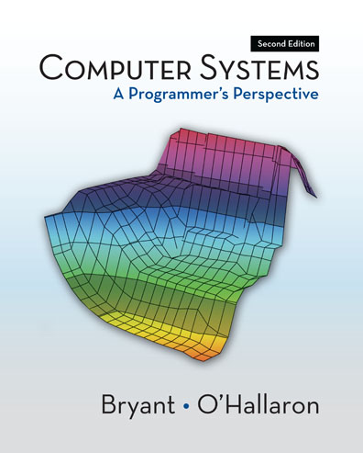
Shameless Promotin
  http://csapp.cs.cmu.edu
  Second edition Published 2010
  In use at 186 institutions worldwide

Slide 44
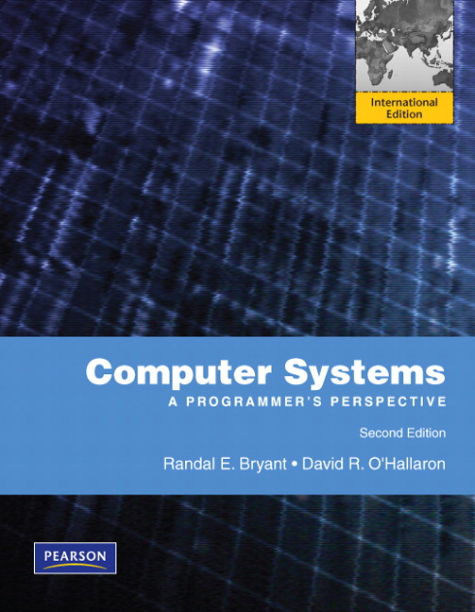
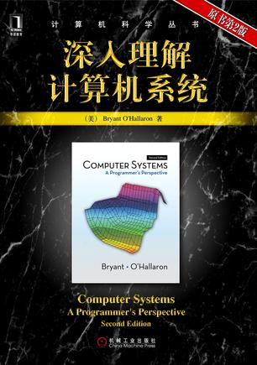
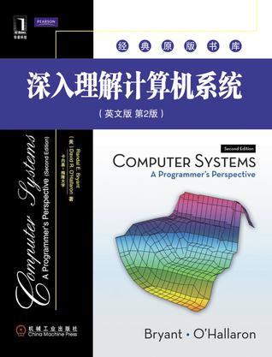
International Editions

Slide 45
Overall Sales
  First + Second Editions
  As of 12/31/2011
  116,574 total

Slide 46
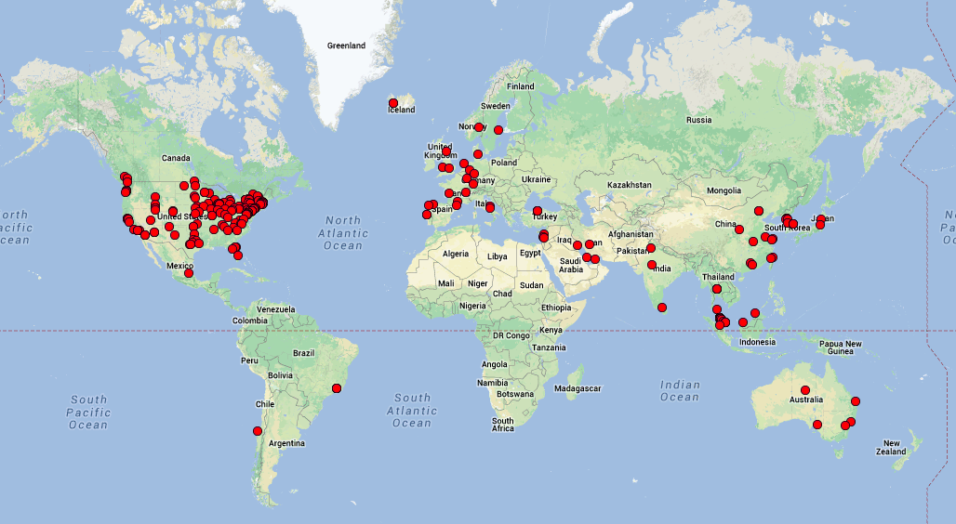
Worldwide Adoptions
237 total

Slide 47
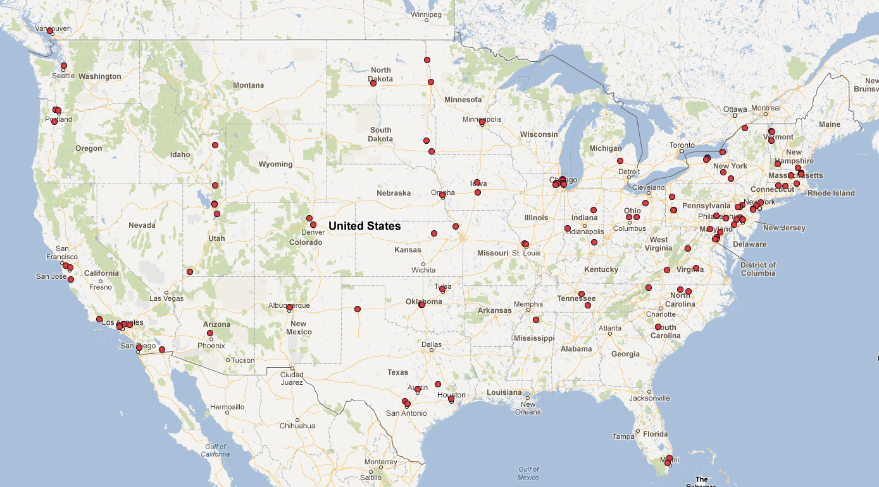
North American Adoptions
114 total

Slide 48
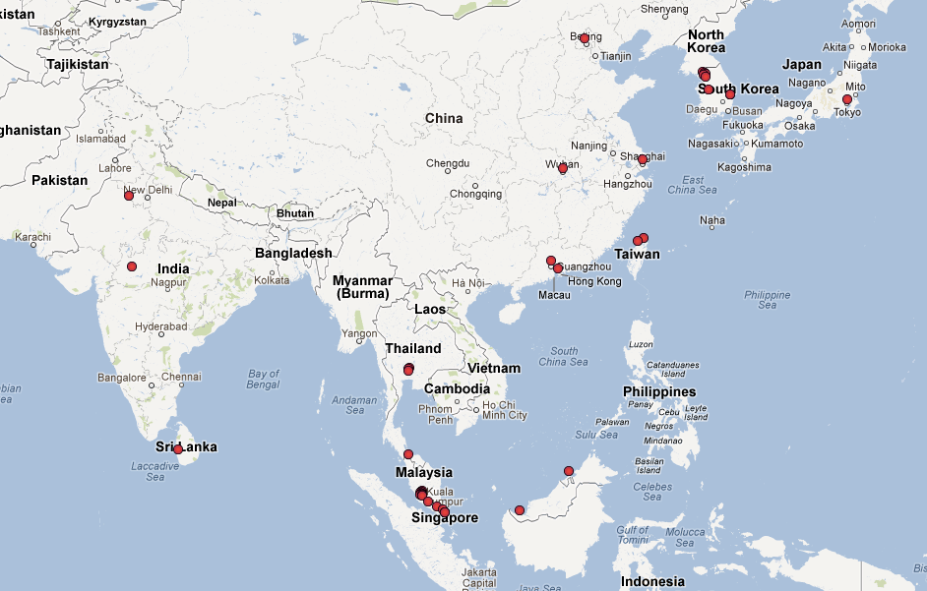
Asian Adoptions

Slide 49
CS:APP2e
Vital stats:
  12 chapters
  233 practice problems (solutions in book)
  180 homework problems (solutions in instructor’s manual)
  475 figures, 282 line drawings
  Many C & machine code examples
Turn-key course provided with book:
  Electronic versions of all code examples.
  Powerpoint, EPS, and PDF versions of each line drawing
  Password-protected Instructors Page, with Instructor’s Manual, Lab Infrastructure, Powerpoint lecture notes, and Exam problems.

Slide 50
Coverage
Material Used by ICS at CMU
  Pulls together material previously covered by multiple textbooks, system programming references, and man pages
Greater Depth on Some Topics
  Dynamic linking
  I/O multiplexing
Additional Topic
  Computer Architecture
  Added to cover all topics in “Computer Organization” course

Slide 51
Architecture
Material
  Y86 instruction set
    Simplified/reduced IA32
  Implementations
    Sequential
    5-stage pipeline
Presentation
  Simple hardware description language to describe control logic
  Descriptions translated and linked with simulator code
Labs
  Modify / extend processor design
    New instructions
    Change branch prediction policy
  Simulate & test results

Slide 52
Web Asides
  Supplementary material via web
  Topics either more advanced or more arcane
Examples
  Boolean algebra & Boolean rings
  Combining assembly & C code
  x87 and SSE floating point code
  Using SIMD instructions
  Asynchronous signal safety

Slide 53
Courses Based on CS:APP
Computer Organization
  ORG Topics in conventional computer organization course, but with a different flavor
  ORG+ Extends computer organization to provide more emphasis on helping students become better application programmers
Introduction to Computer Systems
  ICS Create enlightened programmers who understand enough about processor/OS/compilers to be effective
  ICS+ What we teach at CMU. More coverage of systems software
Systems Programming
  SP Prepare students to become competent system programmers

Slide 54
Courses Based on CS:APP
Chapter | Topic | Course
 |  | ORG | ORG+ | ICS | ICS+ | SP
1 | Introduction |  |  |  |  | 
2 | Data representations |  |  |  |  | 
3 | Machine language |  |  |  |  | 
4 | Processor architecture |  | 
5 | Code optimization |  |  |  | 
6 | Memory hierarchy |  |  |  |  | 
7 | Linking |  |  |  |  | 
8 | Exceptional control flow |  |  |  |  | 
9 | Virtual memory |  |  |  |  | 
10 | System-level I/O |  |  |  |  | 
11 | Concurrent programming |  |  |  |  | 
12 | Network programming |  |  |  |  | 
 Partial Coverage  Complete Coverage

Slide 55
Conclusions
ICS Has Proved Its Success
  Thousands of students at CMU over 13 years
  Positive feedback from alumni
  Positive feedback from systems course instructors
CS:APP is International Success
  Supports variety of course styles
  Many purchases for self study

