Slide 1

Cloak & Dagger: Dynamics of Web Search Cloaking
David Y. Wang, Stefan Savage, Geoffrey M. Voelker
University of California, San Diego

Slide 2
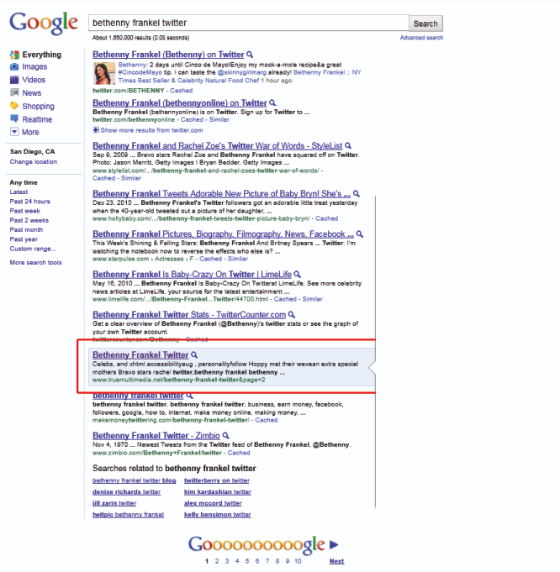
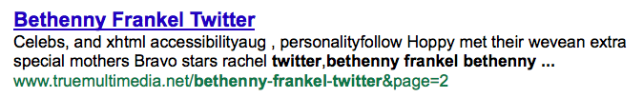
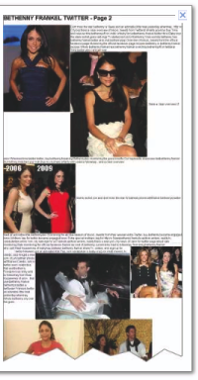
What is Cloaking?
Notes:
I want to begin w/ a example
Let’s say it’s may and you search for bethenny frankel

Slide 3
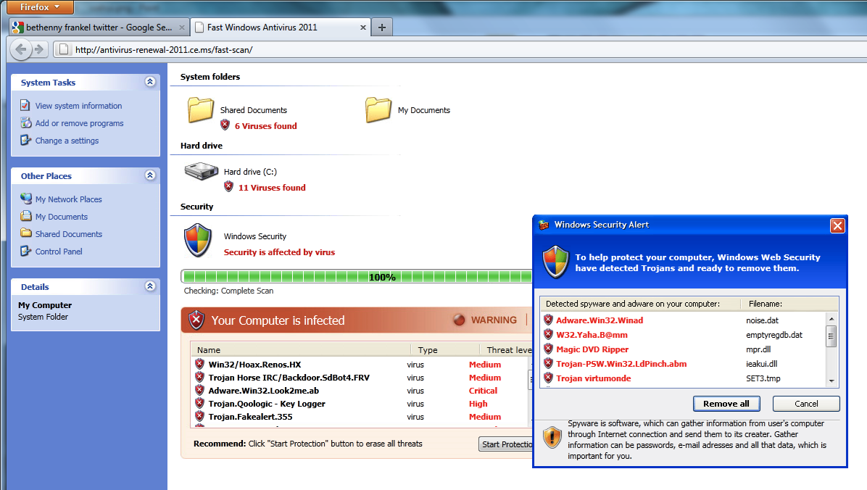
Bethenny Frankel?

Slide 4
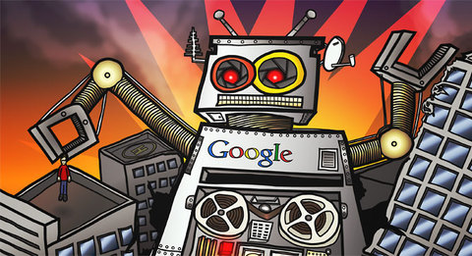

How Does Cloaking Work?
Googlebot visits http://www.truemultimedia.net/bethenny-frankel-twitter&page=2
Hi Googlebot,
I’ve got some
content for you
GET … HTTP/1.1
…
User-Agent: Googlebot/2.1
Notes:
Now I’m going to walk you guys through what happened step by step

Slide 5
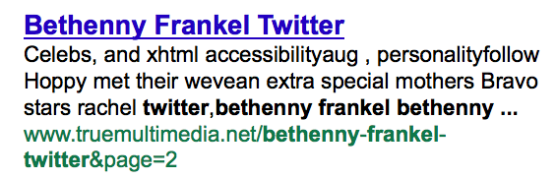
Customized Content for Crawler
Googlebot receives content related to “bethenny frankel twitter”

Slide 6

Google Indexes Content

Slide 7
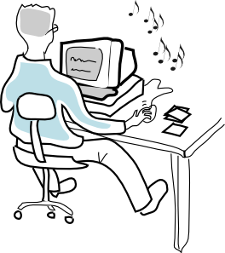
Poisoned Search Results
User clicks on the search result linking to http://www.truemultimedia.net/bethenny-frankel-twitter&page=2
It’s traffic!
… I mean a user…
$$$
GET … HTTP/1.1
…
User-Agent: Firefox
Referer: http://www.google.com/

Slide 8
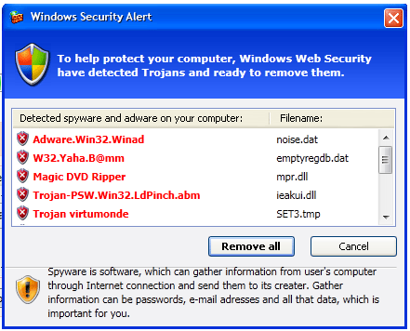
Scam Content for User

Slide 9
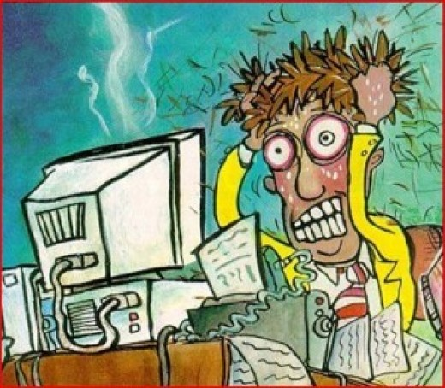
User gets 0wned

Slide 10
What is Cloaking?
Blackhat search engine optimization (SEO) technique
  Delivers different content to different types of users (search crawler, visitor, site owner)
    SEO-ed page → search crawler
    Scam page → visitor
    Benign page → site owner of compromised host
Used to obtain search traffic illegitimately by gaming search results
  Users click on search result, taken to scams
  Clicks “monetized” by scams: fake A/V, pay-per-click, etc.

Slide 11
Why is this a problem?
From users perspective
  Bad experience
  Yet another vector for scams
  Compromised hosts
From search engines perspective
  Poisoned search results impact quality
  Increase complexity to detect + defend against cloaking

Slide 12

Repeat Cloaking
Scammer returns the scam first time, then benign content afterwards
yes
first visit?
no
12

Slide 13
User-Agent Cloaking
Scammer examines the HTTP header for User-Agent [Gyöngyi05]
yes
User-Agent
is firefox?
GET … HTTP/1.1
…
User-Agent: Firefox
no

Slide 14

Referer Cloaking
Scammer examines the HTTP header for Referer [Wang06]
yes
clicked thru
google.com ?
GET … HTTP/1.1
…
Referer: http://www.google.com/
no

Slide 15
IP Cloaking
Scammer maps request IP address to known range [Gyöngyi05]
no
Google IP?
yes
IP: 12.34.56.78
Notes:
Very effective at ensuring only google sees your SEO page, but this isn’t a problem for us in detecting cloaking because we don’t need SEO page, just a diff page than scam

Slide 16
Goals
Systematic measurement over time to capture dynamics and trends in cloaking as SEO
  Contemporary picture of cloaking as seen from search engines (Google, Yahoo, Bing)
  Characterize differences based on search term classes
    Trends: dynamic, broad categories
    Pharmacy: static, domain specific
  Time dynamics: lifetime of cloaked pages and search engine response
    Difficult to observe using a snapshot

Slide 17
Approach
We built Dagger, a customized crawler system
  Collects search terms
  Crawls pages from search results
  Cloaking detection
  Repeated measurement over time
Ran for 5 months (March 1, 2011 – August 1, 2011)
Study results from Google, Yahoo, Bing

Slide 18
What Search Terms to Study?
Selected terms represent portion of search index
Use terms cloakers target
  Past work led us to Trends and Pharmacy
  Differences allow us to understand utilization
Trends (dynamic)
  Large set of search terms that change constantly
  Search terms come from various categories
Pharmacy (static)
  Limited set of terms
  One category, pharmacy
Notes:
Bethenny frankel + dallas mavericks
How many different ways can you search for viagra?

Slide 19
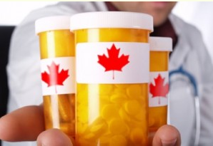




Collecting Search Terms
Maintain feeds for trends and pharmacy sources
Google Suggest adds long tail search terms
viagra 50mg
viagra 50mg canada
Terms
olympics
dallas mavericks
dallas mavericks roster
viagra 50mg
volcano

Slide 20


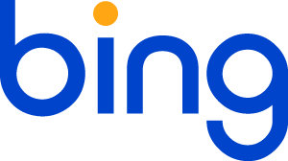
Crawling Search Results
Submit search terms to search engines (Google, Yahoo, Bing)
Collect the top 100 search results per search term
Crawl each unique URL twice:
  Browser (Microsoft Internet Explorer)
  Crawler (Googlebot)
Web Pages
Terms
URLs
olympics
http://…
viagra 50mg
http://…
volcano
http://…
Notes:
After collecting search terms …

Slide 21
Detecting Cloaked Pages
Text Shingling
  Remove near duplicate HTML
Snippet analysis
  Remove HTML (browser) matches snippet
DOM analysis
  Compare HTML structure of browser against crawler
Text
Shingling
Snippet
Analysis
DOM
Analysis
Web Pages
90%
56%
Notes:
After collecting data, we need to detect which pages are cloaking
From a high level, we detect cloaking by determining if the browser + crawler version are different semantically

Slide 22
Data Set
Ran for 5 months (March 1, 2011 – August 1, 2011)
  Trends:
    110 search terms collected every hour (dynamic)
    14K unique URLs crawled every 4 hours per search engine
  Pharmacy:
    230 search terms in total (static)
    16K unique URLs crawled every day per search engine
In total, we crawled 43M search results
  200K cloaked search results for trends
  500K cloaked search results for pharmacy

Slide 23
How Much Cloaking?
Google has the most cloaked search results
  Economies of scale, Google has the larger market
Trends vs Pharmacy
  Pharmacy 10x volume, less volatility
Notes:
Magnitude or scale of cloaking

Slide 24
Which Terms Poisoned?
Rank | Search Term | % Cloaked
1 | viagra 50mg canada | 61.2 %
2 | viagra 25mg online | 48.5 %
3 | viagra 50mg online | 41.8 %
4 | cialis 100mg | 40.4 %
5 | generic cialis 100mg | 37.7 %
 | … | …
50% | tramadol 50mg | 7.0%
Google Suggest has 2.5+ times more cloaked pages
High variance in % cloaked search results
  Terms selected can introduce bias into results
Notes:
Gives an idea of where cloakers were successful
Long tail vulnerable, bread + butter
Also looked at concentration of cloaked search results per search term

Slide 25
Rate of Search Engines Response?
Search results cleaned when cloaked search result no longer appears in the top 100
  40% (trends), 20% (pharmacy) cleaned after 1st day
  Cloaked search results churn more rapidly than overall
Notes:
Search engines don’t like cloaking and want to stop it
How long do cloakers have before search engine stops them
Measured by re-submitting search terms, checking to see if original search results remain in top 100, if not then cleaned

Slide 26
How Long are Pages Cloaked?
Over 80% of cloaked pages remain cloaked past seven days
  Cloakers have little incentive to stop
  Pages often not well maintained
  Also pages are hidden from site owner
Notes:
A related question is…
Instead of search engines stepping in, when site owners step in or cloakers stop
Measured by recrawling cloaked pages

Slide 27
What is Cloaked?
Focus on trends
Cluster based on DOM structure of browser, then manually label
  Top 62 / 7671 clusters, representing 61% of cloaked search results
  March 1 – May 1
Traffic sales suggest specialization + sophistication
Category | % Cloaked Pages
Traffic Sales | 81.5%
Error | 7.3%
Legitimate | 3.5%
Software | 2.2%
SEO-ed business | 2.0%
PPC | 1.3%
Fake-AV | 1.2%
CPALead | 0.6%
Insurance | 0.3%
Link farm | 0.1%
Notes:
Now I’m going to talk about what is cloaked
These are the scams pushed onto users
Traffic Sales are doorway pages that redirect to scams

Slide 28
What is Cloaked?
Classify the HTML using file size + content as features
Cloaked content is highly dynamic
  Redirects surge
  Errors rise
Matches general timeframe of Fake-AV takedowns
Notes:
To give a better idea of how dynamic the content may be…
Blackhat SEO tied to fake-av

Slide 29
Conclusion
Cloaking remains an active vector for scams
  Fake A/V, pay-per-click, malware
Search engines respond, but not fast enough to prevent monetization
  Majority of cloaked search results persist > 1 day
Clear differences in how search terms can be poisoned
  Trends: < 2% results poisoned, but spread broadly, undifferentiated traffic
  Pharmacy: up to 60% results poisoned, highly focused
Signs of increasing specialization + sophistication in blackhat SEO w/ traffic sales

Slide 30
Thank You!
Questions?

Slide 31
IP Cloaking
Return SEO-ed page only to search engine
Dagger can still detect that cloaking occurs:
  The user must receive the scam for monetization
  If we are detected as a false googlebot, what do we receive?
    Surely not the page that the real googlebot receives
    If we receive the scam, then scammers vulnerable to security crawlers (blacklist) and the site owner (clean up)
    In practice we receive a benign page (index.html)
  Anything other than scam will result in a delta, which we can use for comparison and detection

