Slide 1
Parallelizing the C++ Standard Template Library
Grant Mercer (Gmercer015@gmail.com)
C++Now 2015

Slide 2
About me
Second year student at UNLV, computer science major
Recent work with STE||AR research group
Primarily worked on C++ Standards proposal N4352 inside of HPX
N4352 is a technical specification for extensions for parallelism

Slide 3
Background Information
HPX : A general purpose C++ runtime system for parallel and distributed applications of any scale
Enables programmers to write fully asynchronous code using hundreds of millions of threads

Slide 4
Additional Info HPX
First open source implementation of the ParallelX execution model
    Starvation
    Latencies
    Overhead
    Waiting
Enables programmers to write fully asynchronous code using hundreds of millions of threads

Slide 5
Focus Points
Reasons for a parallel STL
Our experience at HPX
Benchmarking
Pros vs Cons

Slide 6
Why Parallelize the STL?
Multiple cores are here to stay, parallel programming is becoming more and more important.
Scalable performance gains, user flexibility
Build widespread existing practice for parallelism in the C++ standard algorithms library

Slide 7
Standards Proposal N4352
A technical specification for C++ extensions for parallelism, or implementation details for a parallel STL.
Not all algorithms can be parallelized ( e.g. std::accumulate) , so N4352 defines a list of algorithms to be reimplemented

Slide 8
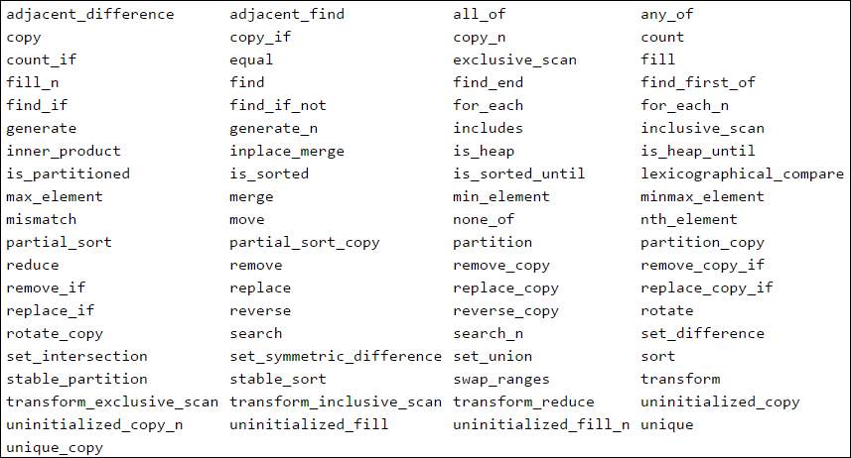
Proposed algorithms

Slide 9
Aimed for acceptance into C++17
Implementation at HPX takes advantage of C++11
Components of TS will lie in std::parallel::experimental::v1 . Once standardized they are expected to be placed in std
HPX implementation lies in hpx::parallel

Slide 10
All algorithms will conform to their predecessors, no new requirements will be placed on the functions.
template< class ForwardIt1, class ForwardIt2 >
ForwardIt1 search( ForwardIt1 first, ForwardIt1 last, ForwardIt2 s_first, ForwardIt2 s_last );
template< class ForwardIt1, class ForwardIt2, class BinaryPredicate >
ForwardIt1 search( ForwardIt1 first, ForwardIt1 last, ForwardIt2 s_first, ForwardIt2 s_last,
BinaryPredicate p );

Slide 11
Inside N4352: Execution Policies
An object of an execution policy type indicates the kinds of parallelism allowed in the execution of the algorithm and express the consequent requirements on the element access functions
Officially supports seq, par, par_vec

Slide 12
std::vector<int> v = ...
// standard sequential sort
std::sort(v.begin(), v.end());
using namespace hpx::parallel;
// explicitly sequential sort
sort(seq, v.begin(), v.end());
// permitting parallel execution
sort(par, v.begin(), v.end());
// permitting vectorization as well
sort(par_vec, v.begin(), v.end());
// sort with dynamically-selected execution
size_t threshold = ...
execution_policy exec = seq;
if (v.size() > threshold)
{
exec = par;
}
sort(exec, v.begin(), v.end());

Slide 13
Par: It is the caller’s responsibility to ensure correctness
Data races and deadlocks are the caller’s job to prevent, the algorithm will not do this for you.
Example of what not to do ( data race )
using namespace hpx::parallel;
int a[] = {0,1};
std::vector<int> v;
for_each(par, std::begin(a), std::end(a), [&](int i) {
v.push_back(i*2+1);
});

Slide 14
Just because you type par, doesn’t mean you’re guaranteed parallel execution due to iterator requirements.
You are permitting the algorithm to execute in parallel, not forcing it
For example, calling copy with input iterators and a par tag will execute sequentially. Input iterators cannot be parallelized !

Slide 15
Exception reporting behavior
If temporary resources are required and none are available, throws std::bad_alloc
If the invocation of the element access function terminates with an uncaught exception for par, seq : all uncaught exceptions will be contained in an exception_list

Slide 16
Task execution policy for HPX
The task policy was added by us at HPX to give users a choice of when to join threads back into the main program. Returns an hpx::future of the result
// permitting parallel execution
auto f =
sort(par(task), v.begin(), v.end());
...
f.wait()

Slide 17
Initial Parallel Design: Partitioning
All algorithms given by the proposal are passed a range, which must be partitioned and executed in parallel.
There are a couple different types of partitioners we used at HPX

Slide 18
foreach_partitioner
The simplest of partitioners, splits a set of data into equal partitions and invokes a passed function on each subset of the data.
Mainly used in algorithms such as foreach, fill where each element is independent and not part of any bigger picture

Slide 19
{1, 2, 3, 4, 5, 6, 7, 8, 9, 10, 11, 12}
{1, 2, 3, 4} | {5, 6, 7, 8} | {9, 10, 11, 12}
f([1,2,3,4]) | f([5,6,7,8]) | f([9,10,11,12])

Slide 20
for_each_n
template <typename ExPolicy, typename F>
static typename detail::algorithm_result<ExPolicy, Iter>::type
parallel(ExPolicy const& policy, Iter first, std::size_t count, F && f)
{
if (count != 0)
{
return util::foreach_n_partitioner<ExPolicy>::call( policy, first, count,
[f](Iter part_begin, std::size_t part_size)
{
util::loop_n(part_begin, part_size, [&f](Iter const& curr)
{
f(*curr);
});
});
}
return detail::algorithm_result<ExPolicy, Iter>::get( std::move(first));
}

Slide 21
partitioner
Similar to foreach, but the result of the invocation of the function on each subset is stored in a vector and an additional function is invoked and passed that vector
Useful in a majority of algorithms copy, find, search, etc..

Slide 22
{1, 2, 3, 4, 5, 6, 7, 8, 9, 10, 11, 12}
{1, 2, 3, 4} | {5, 6, 7, 8} | {9, 10, 11, 12}
v =
{f([1,2,3,4]) , f([5,6,7,8]) , f([9,10,11,12])}
g(v)

Slide 23
reduce
template <typename ExPolicy, typename FwdIter, typename T_, typename Reduce>
static typename detail::algorithm_result<ExPolicy, T>::type
parallel(ExPolicy const& policy, FwdIter first, FwdIter last, T_ && init, Reduce && r)
{
// check if first == last , return initial value if true
return util::partitioner<ExPolicy, T>::call( policy,
first, std::distance(first, last),
[r](FwdIter part_begin, std::size_t part_size) -> T
{
T val = *part_begin;
return util::accumulate_n(++part_begin, --part_size,
std::move(val), r);
},
hpx::util::unwrapped([init, r](std::vector<T> && results)
{
return util::accumulate_n(boost::begin(results),
boost::size(results), init, r);
}));
}

Slide 24
parallel vector dot product
No intermediate function , forces us to use a tuple instead of a simple double
Reduce requirements can not be worked around, a new function is needed
Point result =
std::experimental::parallel::reduce(
std::experimental::parallel::par,
std::begin (values),
std::end(values),
Point{0.0, 0.0},
[](Point res, Point curr)
{
return Point{
res.x * res.y + curr.x * curr.y, 1.0};
}
);

Slide 25
parallel vector dot product
tuple<double,double> result =
hpx::parallel::reduce(hpx::parallel::par,
make_zip_iterator(boost::begin(xvalues),boost::begin(yvalues)),
make_zip_iterator(boost::end(xvalues), boost::end(yvalues)),
hpx::util::make_tuple(0.0,0.0),
[](tuple<double, double> res, reference it) {
return hpx::util::make_tuple(
get<0>(res) + get<0>(it) * get<1>(it),
1.0);
});
N4352 is the newest revision to include transform_reduce , as proposed by N4167
Without transform_reduce , the solution was horribly hacky

Slide 26
transform_reduce
template <typename ExPolicy, typename FwdIter, typename T_, typename Reduce, //…
static typename detail::algorithm_result<ExPolicy, T>::type
parallel(ExPolicy const& policy, FwdIter first, FwdIter last, T_ && init, Reduce && r, Convert && conv)
{
// check if first == last , return initial value if true
typedef typename std::iterator_traits<FwdIter>::reference reference;
return util::partitioner<ExPolicy, T>::call( policy, first,
std::distance(first, last),
[r, conv](FwdIter part_begin, std::size_t part_size) -> T
{
T val = conv(*part_begin);
return util::accumulate_n(++part_begin, --part_size, std::move(val),
[&r, &conv](T const& res, reference next)
{
return r(res, conv(next));
});
},
hpx::util::unwrapped([init, r](std::vector<T> && results)
{
return util::accumulate_n(boost::begin(results),
boost::size(results), init, r);
}));
}

Slide 27
simplified dot product
int hpx_main()
{
std::vector<double> xvalues(10007);
std::vector<double> yvalues(10007);
std::fill(boost::begin(xvalues), boost::end(xvalues), 1.0);
std::fill(boost::begin(yvalues), boost::end(yvalues), 1.0);
using ...;
double result =
hpx::parallel::transform_reduce( hpx::parallel::par,
make_zip_iterator(boost::begin(xvalues), boost::begin(yvalues)),
make_zip_iterator(boost::end(xvalues), boost::end(yvalues)),
[](tuple<double, double> r)
{
return get<0>(r) * get<1>(r);
},
0.0,
std::plus<double>()
);
hpx::cout << result << hpx::endl;
return hpx::finalize();
}

Slide 28
scan_partitioner
The scan partitioner has 3 steps, the first step partitions the data and invokes the first function. Step two invokes a second function as soon as the current and left partition are ready and lastly a third function is invoked in the resultant vector of step 2.
Specific cases such as copy_if, inclusive/exclusive_scan

Slide 29
{1, 2, 3, 4, 5, 6, 7, 8, 9, 10, 11, 12}
{1, 2, 3, 4} | {5, 6, 7, 8} | {9, 10, 11, 12}
v₀ =
{f([1,2,3,4]) , }
v₁ =
{ , }
f([5,6,7,8])
f([9,10,11,12])
r =
{ g(v₀) , }
g(v₁)
h(r)

Slide 30
copy_if
int lst[] = {1, 1, 1, 1, 2, 2, 1, 1, 2, 1, 2, 2, 1}
int res[8];
hpx::parallel::copy_if(par, boost::begin(lst), boost::end(lst), boost::begin(res), [](int i){ return i == 1; });
1 1 1 1 2 2 1 1 2 1 2 2 1
1 1 1 1 1 1 1 1
Not just as simple as copying what returns true, the result array is not ‘squashed’

Slide 31
copy_if
typedef util::scan_partitioner<ExPolicy, Iter, std::size_t> scan_partitioner_type;
return scan_partitioner_type::call(
policy, hpx::util::make_zip_iterator(first, flags.get()),
count, init,
[f](zip_iterator part_begin, std::size_t part_size) -> std::size_t
{
// flag any elements to be copied
},
hpx::util::unwrapped( [](std::size_t const& prev, std::size_t const& curr)
{
// Determine distance to advance dest iter for each partition
return prev + curr;
}),
[=](std::vector<hpx::shared_future<std::size_t> >&& r,
std::vector<std::size_t> const& chunk_sizes) mutable -> result_type
{
// Copy the elements into dest in parallel
}
);

Slide 32
Designing Parallel Algorithms
Some algorithms are easy to implement, others …. not so much
Start simple, work up the grape vine towards more difficult algorithms
Concepts from simple algorithms can be brought into more difficult and complex solutions

Slide 33
fill_n
parallel fill_n is now implemented in just two lines total taking advantage of for_each_n
template <typename ExPolicy, typename T>
static typename detail::algorithm_result<ExPolicy, OutIter>::type
parallel(ExPolicy const& policy, OutIter first, std::size_t count, T const& val)
{
typedef typename std::iterator_traits<OutIter>::value_type type;
return
for_each_n<OutIter>().call(
policy, boost::mpl::false_(), first, count,
[val](type& v) {
v = val;
});
}

Slide 34
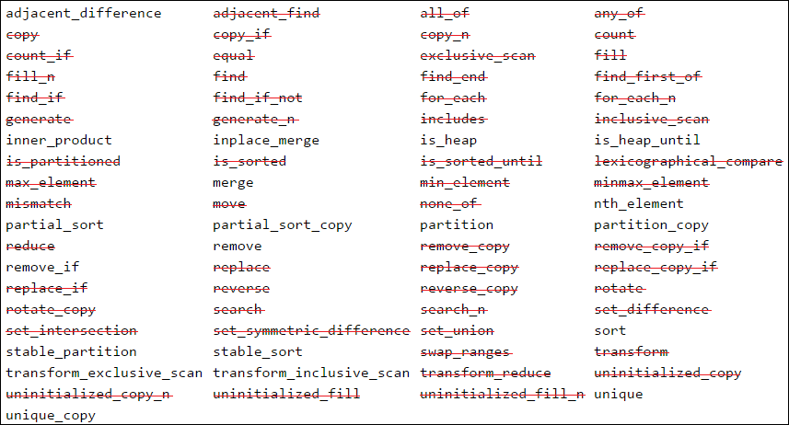
Completed algorithms as of today

Slide 35
void measure_parallel_foreach(std::size_t size)
{
std::vector<std::size_t> data_representation(size);
std::iota(boost::begin(data_representation), boost::end(data_representation),
std::rand());
// invoke parallel for_each
hpx::parallel::for_each(hpx::parallel::par(chunk_size),
boost::begin(data_representation),
boost::end(data_representation),
[](std::size_t)
{
worker_timed(delay);
}
);
}
boost::uint64_t average_out_parallel(std::size_t vector_size)
{
boost::uint64_t start = hpx::util::high_resolution_clock::now();
// run test_count times to get an average execution time
for(auto i = 0; i < test_count; i++)
measure_parallel_foreach(vector_size);
return (hpx::util::high_resolution_clock::now() - start) / test_count;
}

Slide 36
Benchmarking
Comparing seq, par, task execution policies
Task is special in that executions can be written to overlap
User can wait to join execution after multiple have been sent off

Slide 37
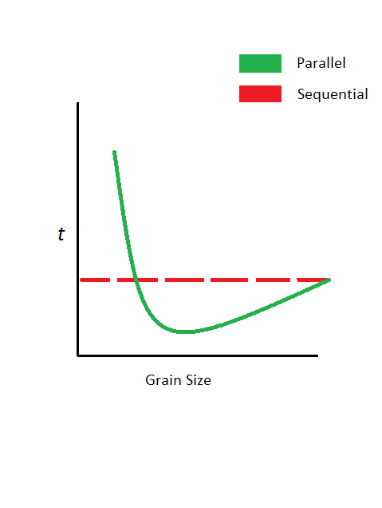
Getting the most out of performance
The big question is whether these functions actually offer a gain in performance when used.
Grain size: amount of work executed per thread.
In order to test this we look to simulate the typical strong scaling graph:

Slide 38
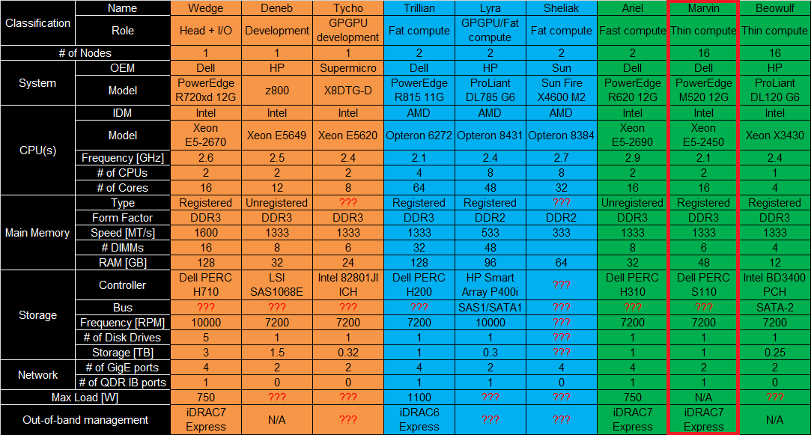
Hardware Used

Slide 39
Sequential vs. Parallel
500 nanosecond delay per iteration
Vector size of 10,000
Sequential
Parallel

Slide 40
Sequential vs. Parallel
1000 nanosecond delay per iteration
Vector size of 100,000
Sequential
Parallel

Slide 41
Parallel vs. Task
1000 nanosecond delay per iteration
Vector size of 1,000,000
Sequential
Task
Parallel

Slide 42
HPXCL: OpenCL backend
OpenCL is a framework for writing programs that execute across heterogeneous platforms consisting of CPUs GPUs DSPs FPGAs
Highly portable

Slide 43
HPXCL : OpenCL backend
Uses hpx::parallel::for_each
  Grouping work-items into work packets
hpx::parallel::for_each(hpx::parallel::par,
nd_range_iterator::begin(dim_x, dim_y, dim_z),
nd_range_iterator::end(dim_x, dim_y, dim_z),
[&ta](nd_pos const& gid)
{
workgroup_thread(&ta, gid);
});

Slide 44
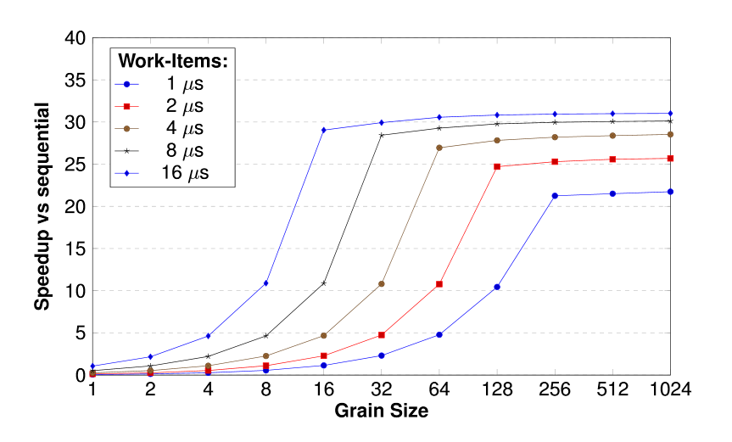

Slide 45
Results
Parallel executions will give a performance boost proportional to the number of cores available.
Significant overhead to overcome initially, scales very well however

Slide 46
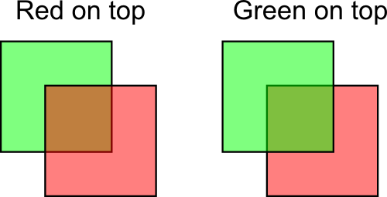

Example Use Case: Particles
When displaying particles with varying alpha values, order matters
One easy way correctly draw a stream of particles is to first sort them by alpha, and draw in order
while( running )
{
// handle events
// for ALL particles in container
// determine next particle location
// SORT particle container
// fill OpenGL buffers
// draw
}

Slide 47


Slide 48
Drawbacks
No resource sharing: each call to an algorithm will create, then destroy resources , no chaining possible.
Getting maximum performance means tweaking your grain size and knowing your execution times. Not always possible

Slide 49
Conclusion
N4352 has shown very promising results for us at HPX
Additional user flexibility in C++ would be a huge benefit, especially with highly scalable code

Slide 50
Additional information
https://github.com/Syntaf
https://github.com/STEllAR-GROUP/hpx
http://stellar.cct.lsu.edu/
https://isocpp.org/blog/2015/01/n4352-53

