Slide 1
Z3 Internals
Nikolaj Bjørner, Microsoft Research, RiSE
Clemens Eisenhofer, TU Wien
Nuno P Lopes, U Lisbon
POPL tutorials, January 16, 2023

Slide 2
Tutorial road-map
Theory Solvers
What to expect when expecting z3?
Quantifiers
Interfacing with z3
Use case
Solver Internals
Tactics
Use case
Solver Engines - CDCL(T)

Slide 3
Material
z3 source on GitHub https://github.com/z3prover/z3
Online guide https://microsoft.github.io/z3guide
Tutorial document https://z3prover.github.io/papers/z3internals.html

Slide 4
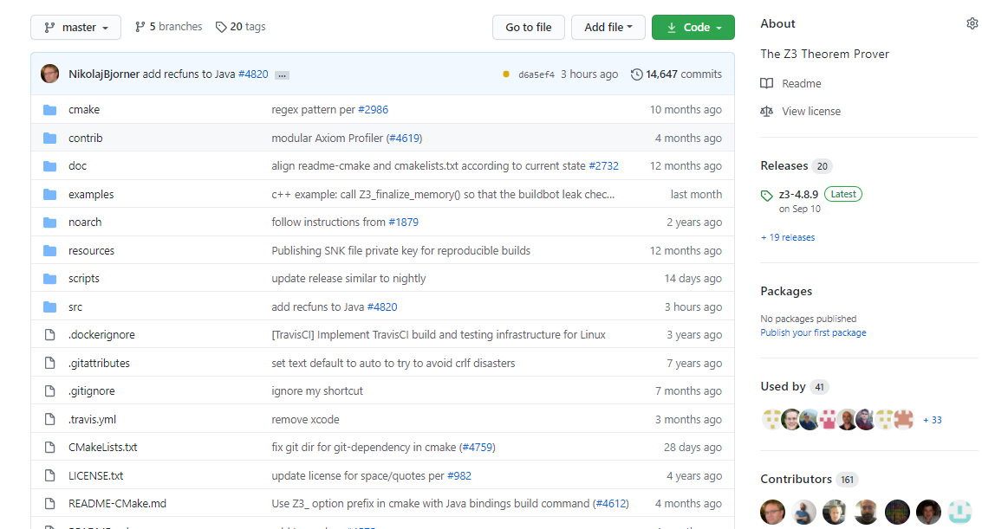
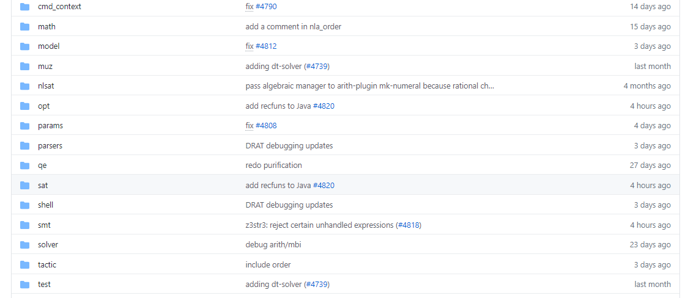
on GitHub
Scope of this tutorial

Slide 5
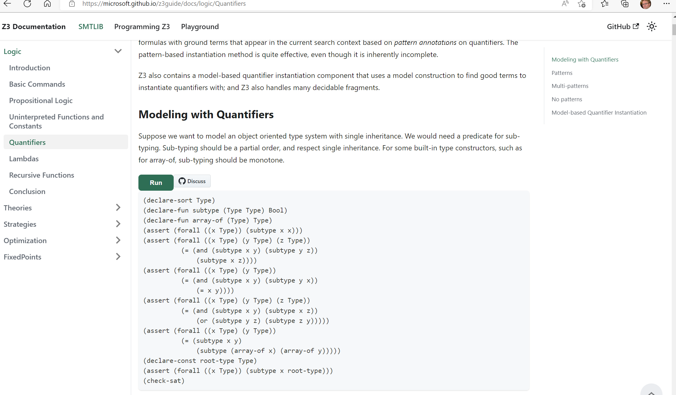
Online guide

Slide 6
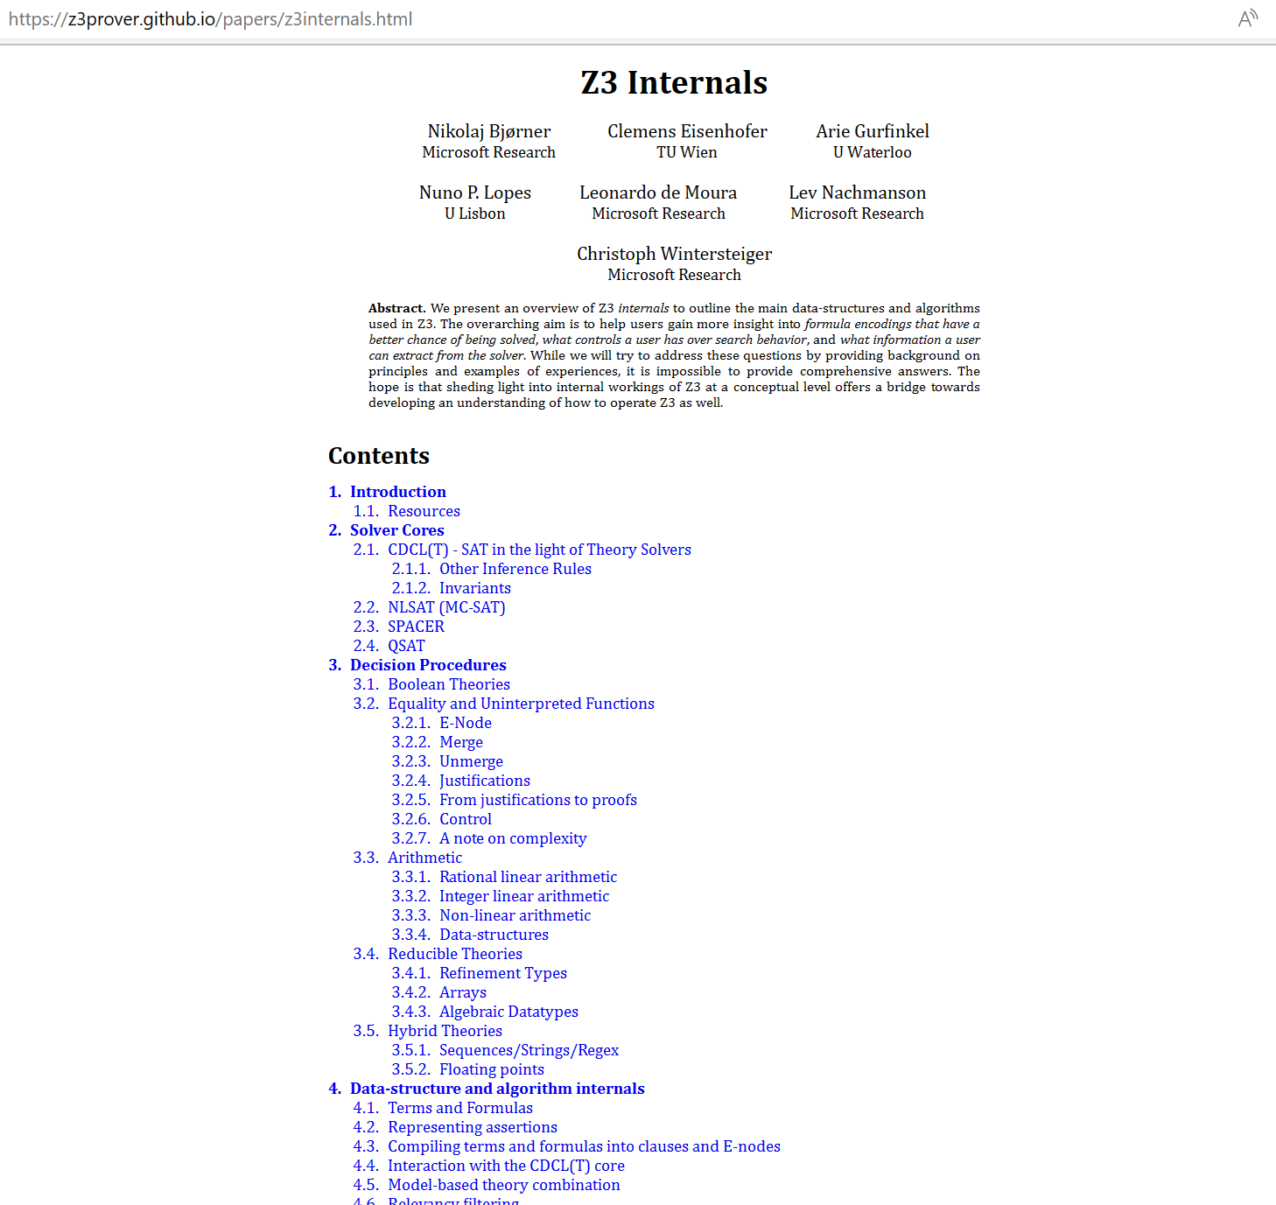
Tutorial document

Slide 7
What to expect when expecting a z3 internals tutorial?

Slide 8
What (some) users want to learn
How can I tune formulas to be solved by Z3?
What features of Z3 should I use for solving formulas?
Can I control the output of Z3
models (to be diverse, random)?
How can I have Z3 provide feedback on solving?
How can I determine which strategies apply to my formulas?

Slide 9
What a developer likes to talk about
Solvers
Algorithms
Data-structures
Logic features
Proof systems
Heuristics
Anatomy of Congruence Closure
How do solvers interact (with the core)?
How do solvers implement search?

Slide 10
Tutorial setup
Exploring Z3 Concepts with use cases
Understand Solver Internals

Slide 11
Encodings, Pre-processing, Search
Encoding
Attainable Speedup $O\left({10}^{6}\right)$
Quantifier encoding
Domain choices
New
Theory solver
Pre-processing (Tactics)
Attainable Speedup $O\left({10}^{4}\right)$
Problem simplification
Automatic reformulation
Advances in Search
Attainable Speedup $O\left({10}^{2}\right)$
Phase caching
T-Propagation
Thanks to D.O.F. Pons

Slide 12
Interfacing with Z3
Some anecdotal experiences

Slide 13
Efficiency
Scale
Technology Landscape
Propositional
Satisfiability Solving
SAT
Breakthroughs in 2000s
Cheap local Inferences
Garbage collect useless clauses
Hardware Design
Automation
Breakthroughs late 2000s
SAT + global inferences +
global propagators
Mixed Integer
Programming
MIP
Breakthroughs in 1960s
Harnessed since 1990s
LP: global Inferences
IP: Cuts, Branch and Bound
Satisfiability Modulo Theories
Operations
Research
CP-SAT
SMT
Z3
Constraint
Programming
Software Development +…
CP
Breakthroughs since 1990s
Powerful domain-tailored
global propagators
Expressive Power

Slide 14
But, what about
Program Verification
using SMT
Proof assistants
using SMT
LEAN?
Stanford Pascal Verifier
NQTHM, ACL2
AutoActive?
ESC/Simplify, STeP
EHDM, PVS
Boogie
Isabelle, Coq Hammers
Imandra, ….

Slide 15
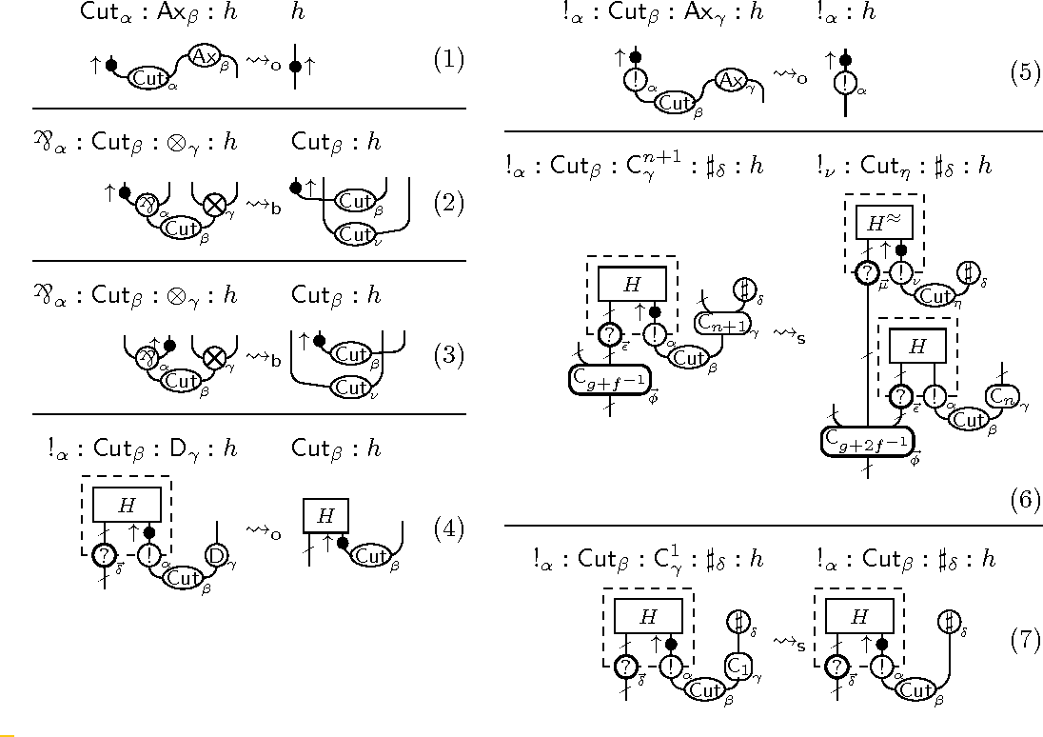
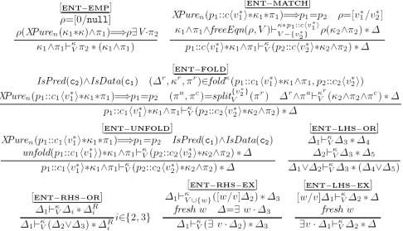
Systems Code Verification: Type theory vs Floyd-Hoare-Dijkstra
FP & Logics
Boogie (2004)
F# (2001)
KISS (2004)
Spec# (2004)
Verve (2010)
F7 (2007)
HAVOC (2010)
VCC (2009)
Vale (2017)
F* (2012)
Dafny (2010)
Chalice (2010)
EverCrypt (2019)
EverParse (2019)
Verona (2022)
Ironfleet (2015)
CIVL (2015)
Viper (2016)
SLAyer (2008)
Steel (2020)
VeriSol (2018)
Armada (2020)
Verus (2022)
Separation Logic (1999)

Slide 16
Verified systems at SOSP, OSDI
Python
IsabelleHOL
seL4 (SOSP 2009)
assembly
Ironclad (OSDI 2014)
Jitk (OSDI 2014)
Dafny
IronFleet (SOSP 2015)
FSCQ (SOSP 2015)
C
Yggdrasil (OSDI 2016)
LLVM
CertiKOS (OSDI 2016)
Komodo (SOSP 2017)
C
DFSCQ (SOSP 2017)
Hyperkernel (SOSP 2017)
CSPEC (OSDI 2018)
Coq
Z3
Nickel (OSDI 2018)
DiskSec (OSDI 2018)
Serval (SOSP 2019)
Rosette
Perennial (SOSP 2019)
Vigor (SOSP 2019)
Go
VeriFast
AtomFS (SOSP 2019)
Jitterbug (OSDI 2020)
GoJournal (OSDI 2021)
Agda
SCFTL (OSDI 2020)
VeriBetrFS (OSDI 2020)
SeKVM/VRM (SOSP 2021)
Knox (OSDI 2022)
DaisyNFS (OSDI 2022)
VIA (OSDI 2022)

Slide 17
Languages for verifying systems code
More like Haskell/ML
More like C/C++
Verified
Rust?
F*
Dafny
VCC
Rust is like Haskell/ML:
Type-safe
Algebraic datatypes
Pattern matching
Side effects are restricted
Rust is like C/C++:
Low-level pointer manipulation
No garbage collector
Structs inside structs
In-place mutation of fields
Rust is unique:
Linear types
Borrowing

Slide 18
Languages for verifying/safe systems code
More like Haskell/ML
More like C/C++
F*
Dafny
Verus
VCC
Full Stack Security
Rust Verification
Steel
Armada
Verona
Rust.Next
Scale to Next Order of Magnitude
Lock Free Data-structures for Critical Infrastructure

Slide 19
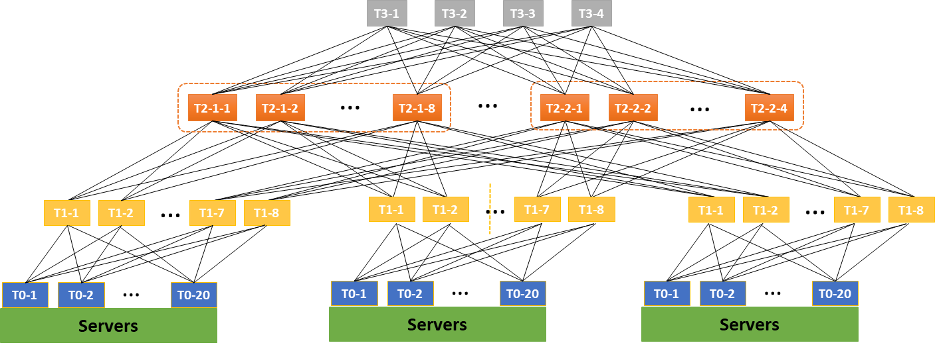
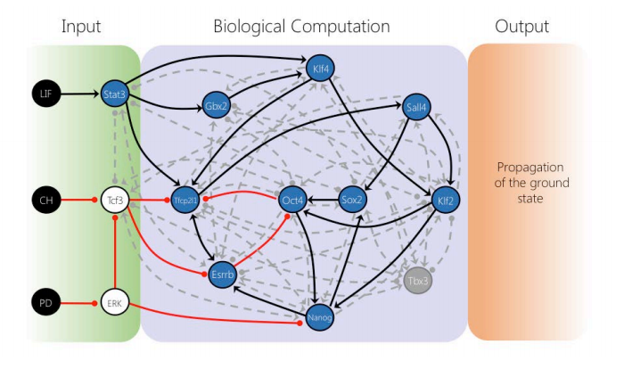
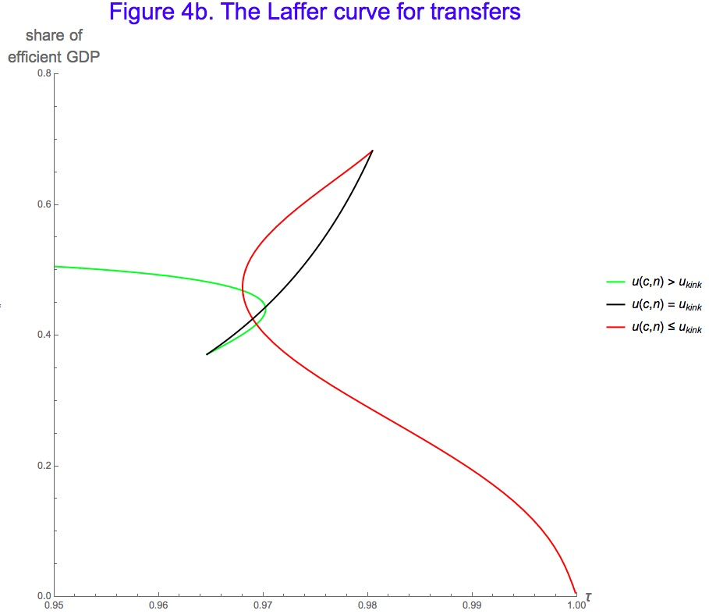
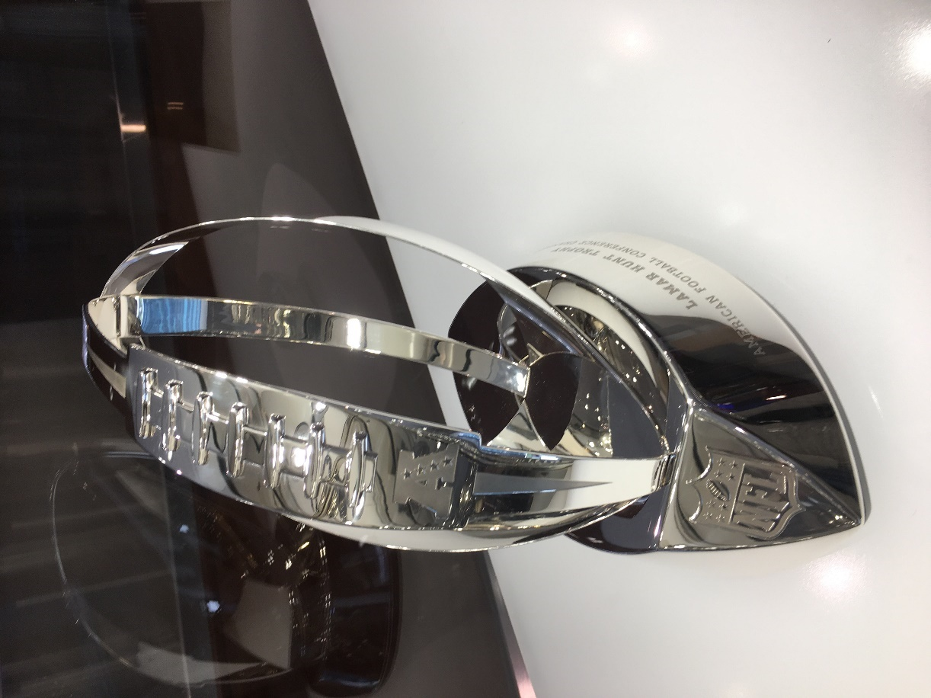
for Software +…
Azure Network
Verification
Verifying C
Compiler
Quantum
Compilation
Biological
Computations
Verified Crypto
Libraries & Protocols
Dynamics
AX
SVACE
Static Analysis Engines
Artificial
Life
Security Risk Detection
Smart Contract
Verification
ALIVE2
Translation Validation
for LLVM & Visual C++
Axiomatic
Economics
NFL
Scheduling

Slide 20
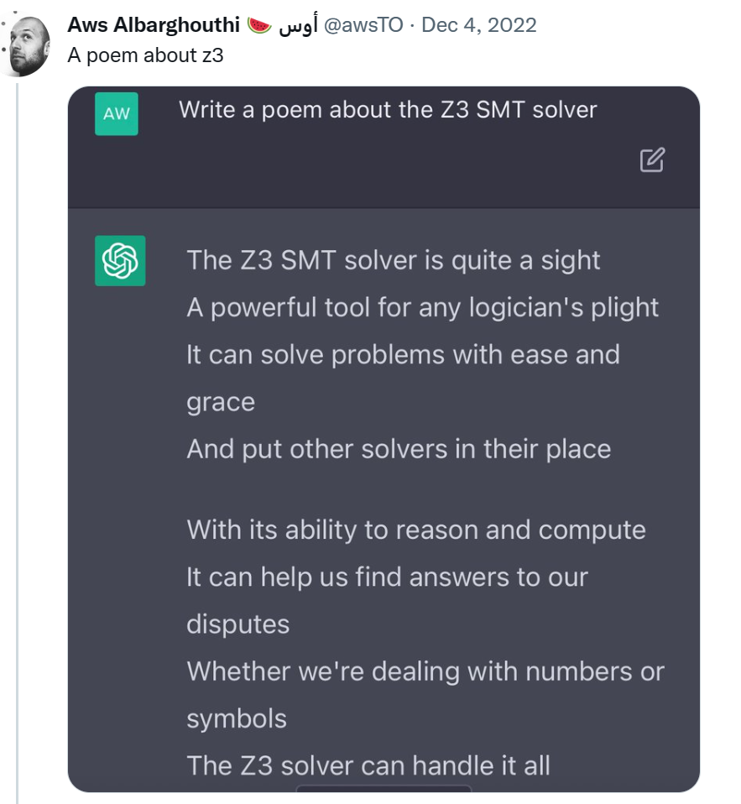
SMT and Proof Assistants
SMT
Feed formulas
No assurance of consistency
Built-in theories
Automation is job #1
Poems? Tables with runtimes
LISP, no editors
Type theory as a distraction
Int, Real
Gigantic trusted kernel
Proof validation
Z3: Algorithms, Heuristics, SE customers
Proof Assistants
Develop and maintain theories
Ensure consistency
Extensible theories
Empower users to automate
Career defining microcosmos
Editors
Powerful type theories (or ACL2)
Church Numerals, Dedekind cuts
Lean trusted kernels
Consistency by construction
LEAN: early aim articulated as “power of Coq with ease of Isabelle”

Slide 21
Encoding – A case study
Solve for:
$station(p): Station$ each process $p$
Auxiliary Functions:
$maxHeight:Station →Nat$
$operator:Station×Zone →Operator$
Assignment Constraints:
$operator\left(station(p),z\right)∈\left\{op_{1},op_{2}\right\}$
$maxHeight\left(station(p)\right)≥height(p)$
We now have height constraint over a process as a function of a variable ranging over Stations.
Process
Task 1
Task 2
Task 3
Task 4
Task 5
Task 6
Process
Task 1
Task 2
Task 3
Task 4
Task 5
Task 6
Process
Task 1
Task 2
Task 3
Task 4
Task 5

Slide 22
Encoding - Domain Overload
Number of Processes = O(1K)
Number of Stations = O(1K)
Number of Tasks = O(10K)
Up to O(10) different operators per station
Direct MIP-style encoding: $t_{i,s,op}$ - Task $i$ is at station $s$ using operator $op$
$10K×1K×10=100M$ variables
SMT approach: Use uninterpreted functions for “symbolic indices”
$operator\left(station(p),z\right)∈\left\{op_{1},op_{2}\right\}$
$maxHeight\left(station(p)\right)≥height(p)$

Slide 23
Encoding - Constraint Overload
a polluting, nasty side constraint
Constrained multi-knapsack:
A set of items, each is added to one knapsack, subject to side-constraints
Z3 approach: Programming Custom Theories (no built-in scheduling constraints)

Slide 24
Encoding – A humble path of discovery
v1: Pre-solving
Assign a small batch of 4-10 processes to stations at a time
v2: Pre-solving take two
Assign just one process at a time and only encode process constraints when a process gets assigned.
The resulting solver can assign 950 out of 1050 processes in a few minutes.
v3: A custom CDCL / CSP solver
Perform branching and propagation of cycle time constraints on top of repeated calls to Z3.
Maintain backtracking stack and add lemmas based on the chosen branches.
This was complex to engineer and only exercised in preliminary form.
v4: with Custom Propagator and Bit-vectors
With bit-vectors, without cycle-time: solvable in 30 seconds.
With bit-vectors and cycle-time: solvable for 300 processes in a few minutes, but not all processes.
With bit-vectors, programmable-propagator for cycle-time: patching + solving
Stations and processes, station heights and task time are integers
Solved 100 processes very slowly.
Initial: a few hours
Current: a few minutes.

Slide 25
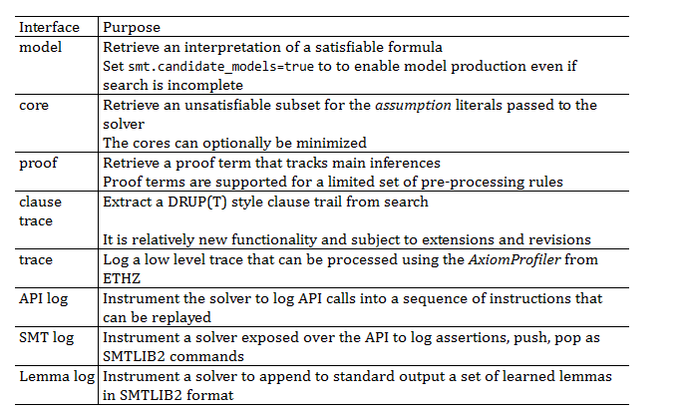
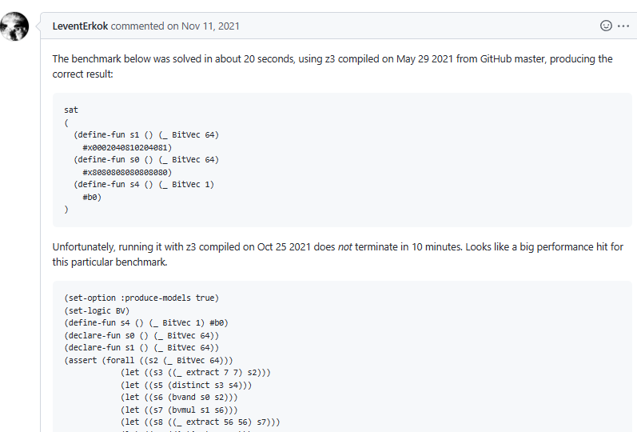
Retrieving Information
A case study in tuning z3

Slide 26
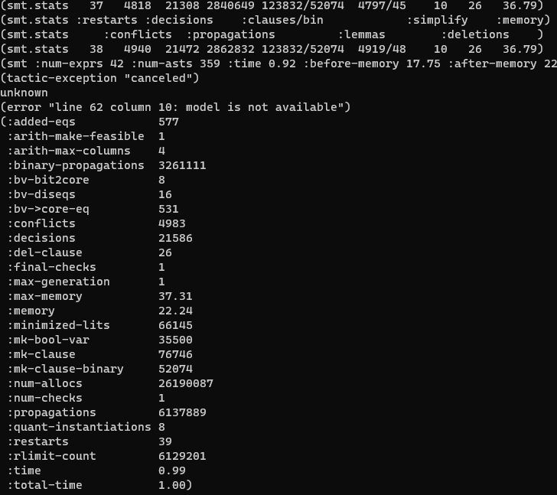
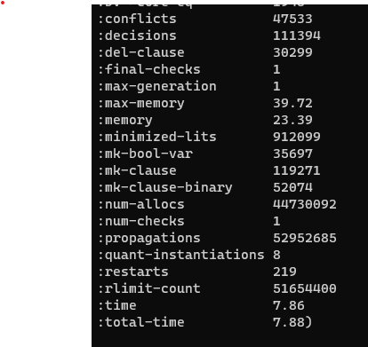
Retrieving Information – for diagnostics
Conflicts grow, but no new quantifier instantiations
First attempt
Run verbose
Get statistics
Very few quantifier instantiations

Slide 27
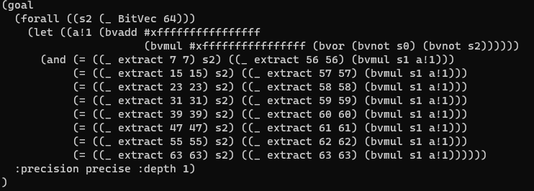
Retrieving Information
So lots of conflicts. No quantifier instantiations.
Stuck with multiplier reasoning?
What formula is being solved?
Where does this funny
-1 – 1*(~s0 | ~s2) come from?
It’s a regression. New rewrite rule that is harmful to solver!
~x = -1 – 1*x

Slide 28
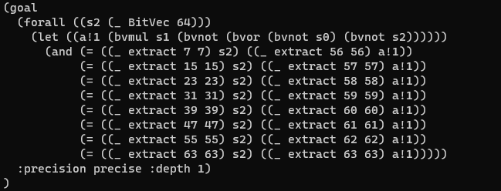
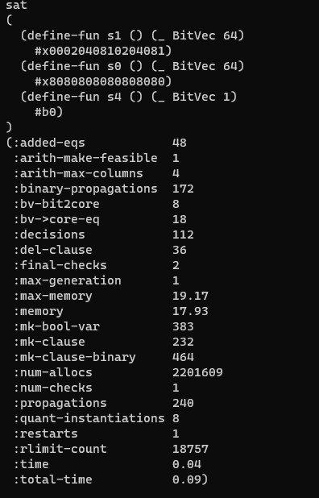
Retrieving Information
Funny rewrite, reverted
It is solved immediately
$$∃s0,s1 ∀s2 \bigwedge_{i}{s2\left[b_{i}:b_{i}\right]=\left(s1∗\left(s2 \& s0\right)\right)[b_{i}^{′}:b_{i}^{′}]}$$

Slide 29
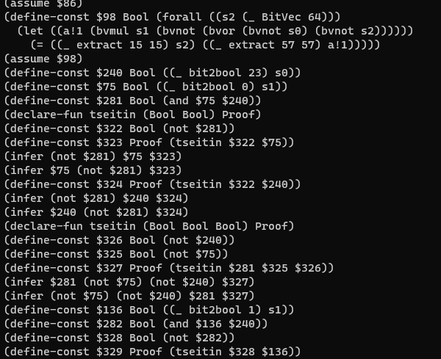
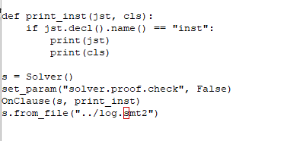
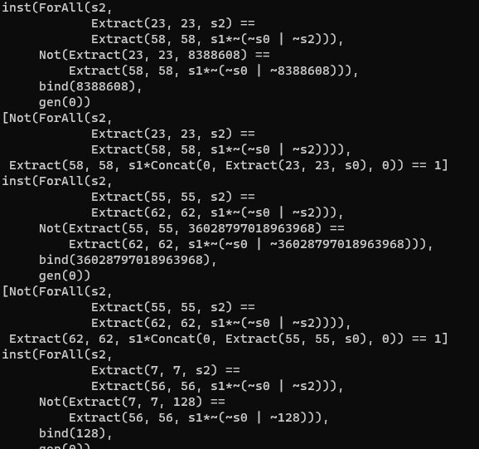
Retrieving Information – what are the inferences? (preview of clause logs)
Log is not readable by itself
But I can write a script to filter through log
It prints instances in Z3’s Python format

Slide 30
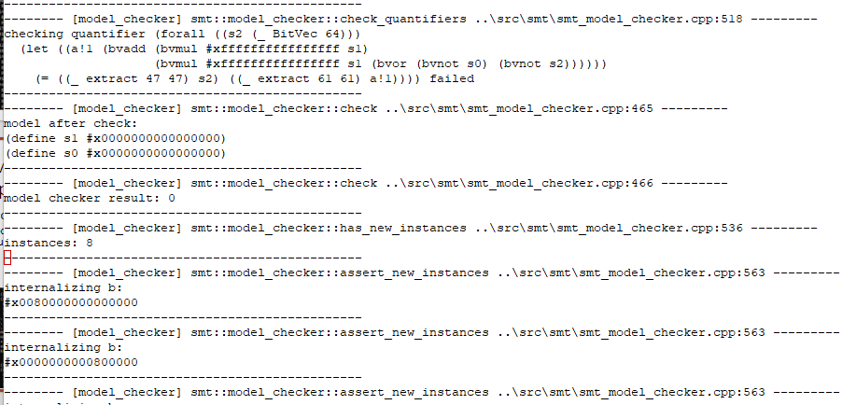
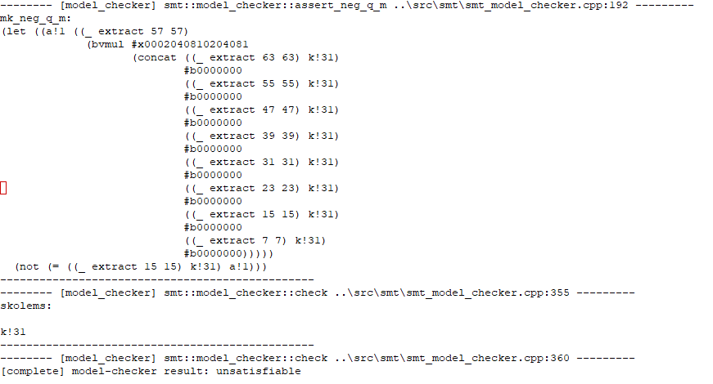
Retrieving information – “I program z3 and I have no life version”
Where does it get stuck?
-tr:model_checker – debug trace what does MBQI do?
Last MBQI check-sat call
(with fix)
Second to last call
(without fix)

Slide 31
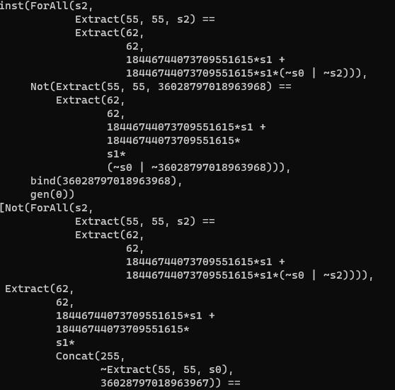
Retrieving information – “I program z3 and I have no life version”
Instances
(without fix)
Instances
(with fix)
Much cheaper for bit-blasting!

Slide 32
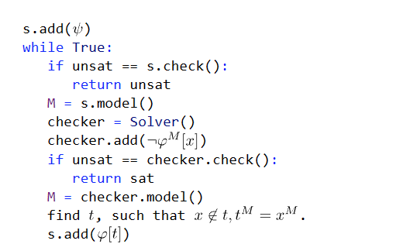
Retrieving information
Initial model for true:
S0 = (_ bv0 64)
S1 = (_ bv0 64)
Check if negation of quantifier body is sat:
Model of check ensures $s2\left[55:55\right]$ = 1
Instantiate
$∀s2 . s2\left[55:55\right]=\left(s1∗\left(s2 \& s0\right)\right)\left[62:62\right]$
By 1 $=\left(s1 ∗ \left(00000000100000.. \& s0\right)\right)\left[62:62\right]$
$=\left(s1 ∗concat\left(0, s0\left[55:55\right],0\right)\right)[62:62]$
How does MBQI work?
$$ψ∧∀xφ$$
$$s2\left[55:55\right]≠\left(0∗\left(s2 \& 0\right)\right)[62:62]$$

Slide 33
Retrieving information - Why not E-matching?
Instantiates quantifier using some term that exists in context
Useful term $s0\left[55:55\right]$ matches $S2\left[55:55\right]$
Instantiation: $s0\left[55:55\right]=\left(s1∗\left(s0 \& s0\right)\right)\left[62:62\right]$
Introduces multiplier circuit
$∀S2 . S2\left[55:55\right]=\left(s1∗\left(S2 \& s0\right)\right)\left[62:62\right]$
1 $=\left(s1 ∗concat\left(0, s0\left[55:55\right],0\right)\right)[62:62]$

Slide 34
Retrieving information
a₀∧b₃
a₀∧b₂
a₀∧b₁
a₀∧b₀
Bit-blasting, cost of multipliers
Multiplier circuits for 64 bits are super expensive
HA
a₁∧b₂
HA
a₁∧b₁
HA
a₁∧b₀
FA
a₂∧b₁
FA
a₂∧b₀
FA
a₃∧b₀
out₃
out₂
out₁
out₀

Slide 35
Retrieving information
Trying QSAT
QSAT solves satisfiability for nested quantifiers.
It works on top of bit-vectors
=> bit-vector multiplier circuit recompiled on every instantiation
(apply (then simplify qsat) :print_statistics true)

Slide 36
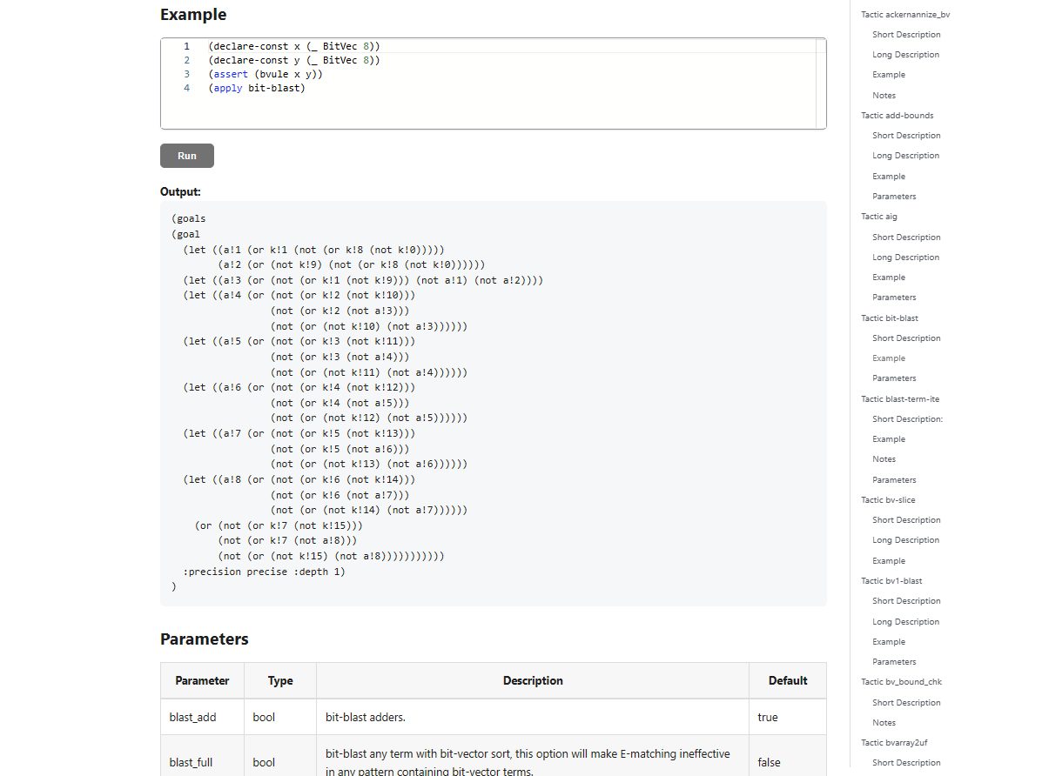
Skip repeated bit-blasting
(apply (then simplify
(with bit-blast :blast_quant true)
qsat) :print_statistics true)
The problem is now pure 2-QBF.
Option:
Feed output of tactic (w/o qsat)
to a dedicated QBF solver.
TODO

Slide 37
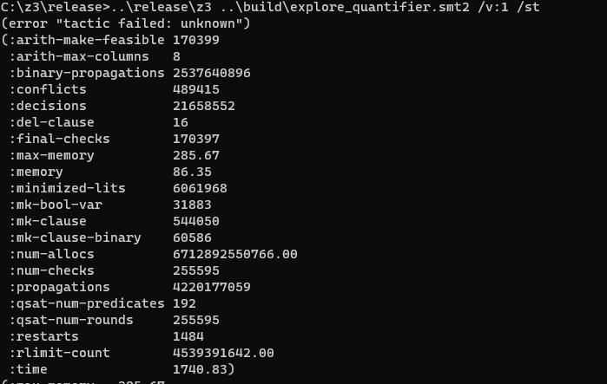
The magic didn’t happen
(apply (then simplify
(with bit-blast :blast_quant true)
qsat) :print_statistics true)
But MBQI also works with bit-blasted:
(check-sat-using (then
simplify
(with bit-blast :blast_quant true)
smt) :print_statistics true)

Slide 38
Revising hypotheses
Was this rewrite the real culprit?
~x = -1 – 1*x

Slide 39
A domain Insight
What are we solving, in a nutshell:
Bit-wise & retains bits from s2 where s0 has bits set to 1
Bit-wise * retains bits form $\left(s2 \& s0\right)$ where s1 has bits set to 1
System is less constrained the fewer bits in s0, s1 are set to 1.
=> Find models for s0, s1 with fewest bits set to 1
$$∃s0,s1 ∀s2 \bigwedge_{i}{s2\left[b_{i}:b_{i}\right]=\left(s1∗\left(s2 \& s0\right)\right)[b_{i}^{′}:b_{i}^{′}]}$$

Slide 40
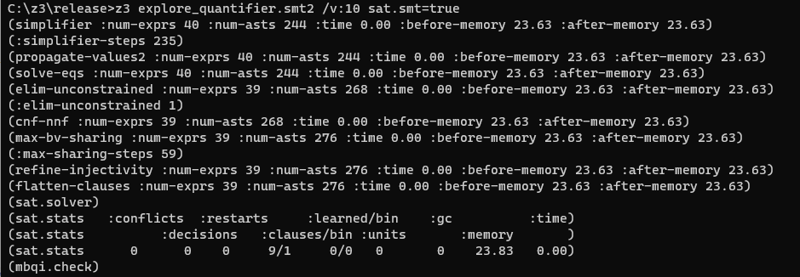
Retrieving information
Uses incremental pre-processing
tinkering with sat.smt=true
TODO

Slide 41
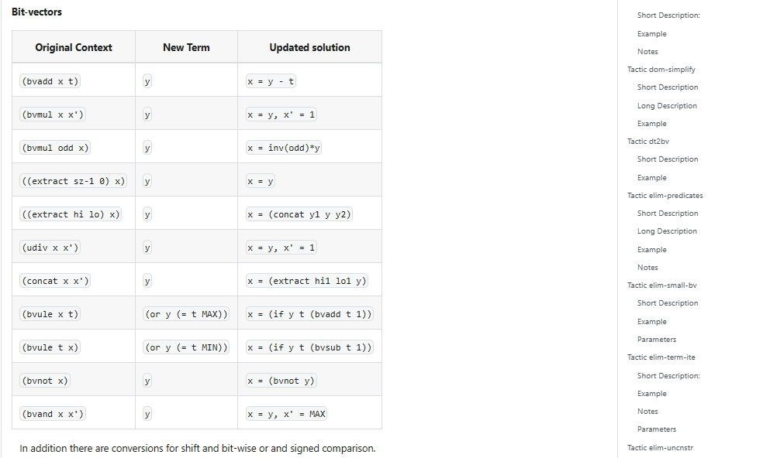
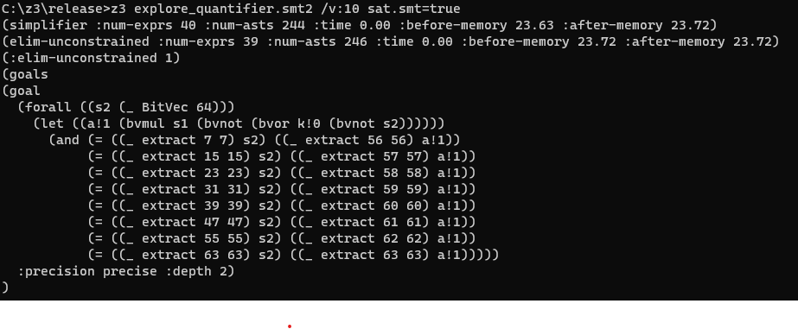
Retrieving information – digging into tactics
$∀s2 . s2\left[55:55\right]=\left(s1∗\left(\sim \left(\sim s2 \right|\sim s0\right))\right)\left[62:62\right]$
~s0 occurs in single position
Replace by fresh variable
Replaced by fresh variable

Slide 42
Retrieving information
After ~s0 was replaced by fresh variable k!0
Bits in k!0 are opposite polarity of s0
Branch ordering based on setting bits in inputs to 0 is broken!

Slide 43
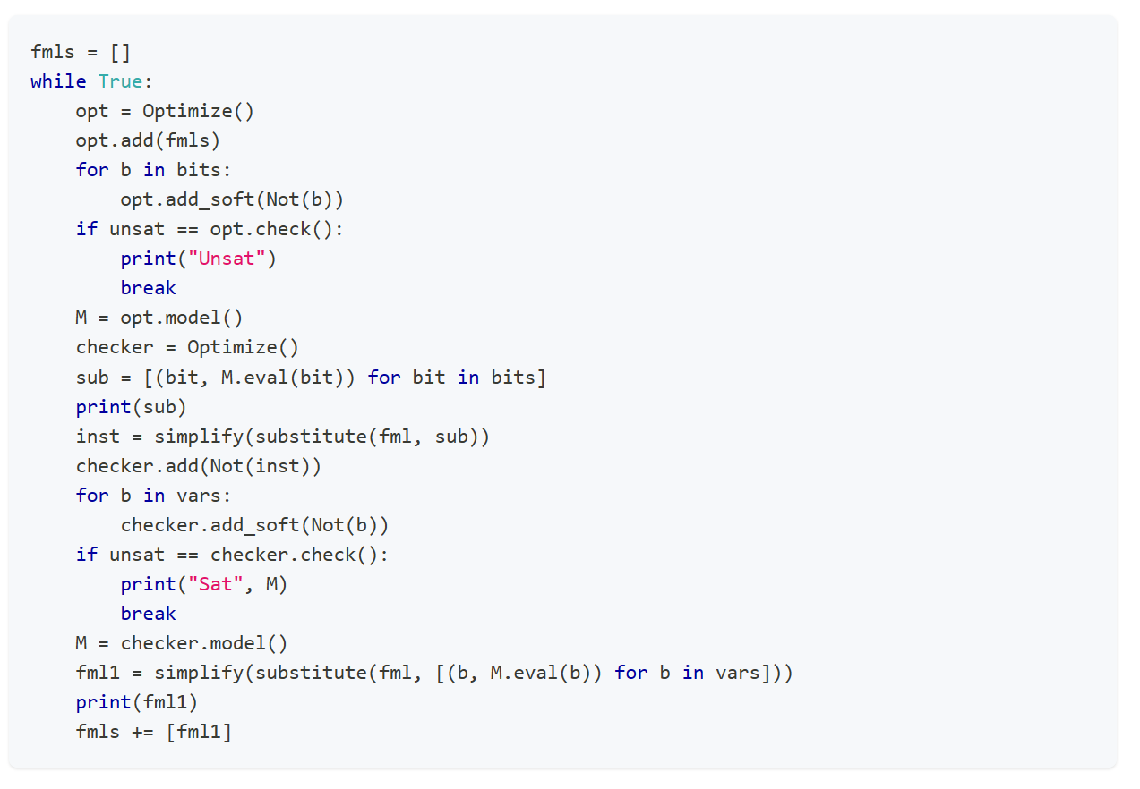
A custom MBQI with optimization
https://Microsoft.github.io/z3guide/programming/Example%20Programs/MBQI
Solves problem very quickly, no dependency on variable phases

Slide 44
Retrieving information - recap
Verbose mode
Statistics
Inspect result from pre-solve (apply simplify)
Instrument Clause Traces
Shape hypotheses, revisit them
Debug traces
Clause traces again

Slide 45
Encoding – generic rules
Introducing helpful predicates
Can a model capture the likes of Ackermann reductions, cuts?
Watch out for N x M overhead. Can you use functions?
CDCL(T) is just horrible at problems with symmetries.
More theories isn’t better. Common trap is mixing bit-vectors with ints.
Use succinct encodings when available, if not use quantifiers or Custom Theories
Break symmetries in encodings
Heed the cost of impure and mixed theories

Slide 46
Encoding – The power of SAT solvers (?)
Z3 is more stable for unsatisfiable problems than satisfiable problems.
Partial control by using knobs such as smt.phase_caching_on=80000, sat.threads=4
CDCL is horrible at xor reasoning. By nature, CDCL SAT searches for regular resolution proofs.
There are no existing knobs to make xor work, but a CryptoMiniSAT T-solver in the works.
SAT is a solved problem, right?

Slide 47
Encoding – CDCL(EUF)
Shifting reasoning about uninterpreted functions to the CDCL SAT core can produce significant speedups
The CDCL core has no E-node overhead, learns strong lemmas
The CDCL core does not scale with encodings that grow by cross-products
Shifting reasoning about uninterpreted functions to the CDCL SAT core is not practical for large formulas

Slide 48
Controlling Search
Z3 does not use cores unless you ask it to
You can parallelize z3 in several ways
parallel.enable=true (cube and conquer)
Solver is super sensitive to tradeoffs in time spent solving vs. cubes created.
sat.threads=4
Run parallel instances of sat core sharing clauses.
smt.threads=4
Run parallel instances of smt core run in multiple rounds using alternate see cubes
tactic.default_tactic=(then simplify (par-or (with smt :smt.random_seed 1) smt))
Parallel tactics, no sharing, no cubing.
Parallel Z3 doesn't offer any speedups
But don’t expect miracles..
you have to tune yourself

Slide 49
Tactics

Slide 50
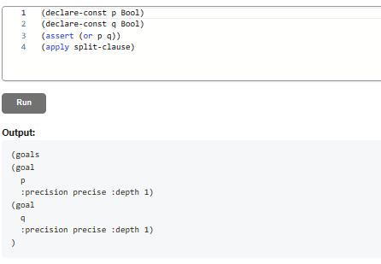
Tactics
$goal: φ$
${subgoals: φ}_{1},…, φ_{k}$
$goal: p∨q$
${subgoals: p q }_{}$
Model of one subgoal converts to model of original goal
Proof of all subgoals convert to proof of original goal

Slide 51
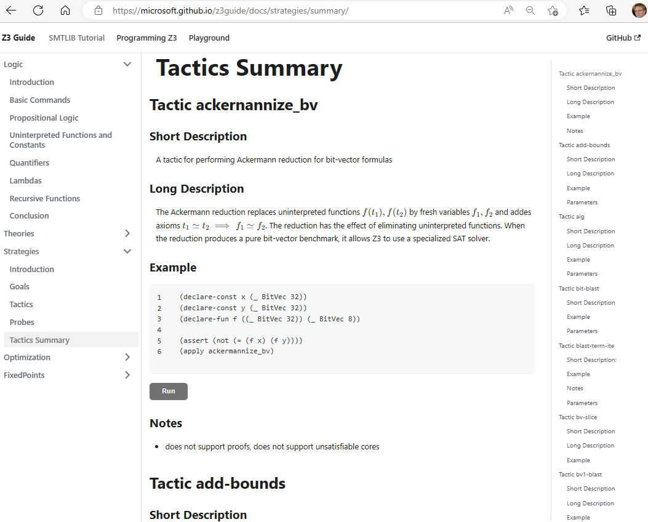
Tactics Online

Slide 52
Tactics – Use case in Alive2
C, C++, ObjC, Rust,
Swift, …
frontend
llvm2alive
static unroll
encode semantics & refinement check
LLVM IR
Alive2 IR
Alive2 IR
LLVM middle-end optimizers
SMT formulas
LLVM IR
Alive2 IR
Alive2 IR
clang, rustc, etc
LLVM
Alive2
UNSAT or partial model
Alive2 tactic

Slide 53
Tactics – Use case Alive2
Alive2 formulas:
bit-vectors, arrays, lambdas, floating-point numbers, EUF, quantifiers
Use only “hardened tactics” for production
Respect memory limits
Always simplifying
Simplifications enable new simplifications
same tactics run multiple times

Slide 54
Tactics –which tactics to use?
A1: it is an “experimental science”
A2: built-in tactics may be classified according to attributes
General
Translations
Theory Specific
nnf
tseitin-cnf
bvarray2uf
bt2bv
eq2bv
card2bv
lia2card
lia2pb pb2bv
fm
purify-arith
bit-blast
Contracting
Expanding
simplify
propagate-values
elim-uncnstr
solve-eqs
qe-lite
qe
blast-term-ite
Reduce Array to EUF
Reduce Arith to finite domains
cxt-simplify
ctx-solver-simplify

Slide 55
Tactics – classification by truth-preservation

Slide 56
Tactics – classification model preservation
Upcoming functionality: Rigid and under-constrained tactics can be used for incremental solving

Slide 57
Solver Engines
CDCL(T) SPACER NLSAT QSAT

Slide 58
Satisfiability Modulo Theories (SMT)
Is formula ϕ satisfiable modulo theory T ?
SMT solvers have specialized algorithms for T

Slide 59
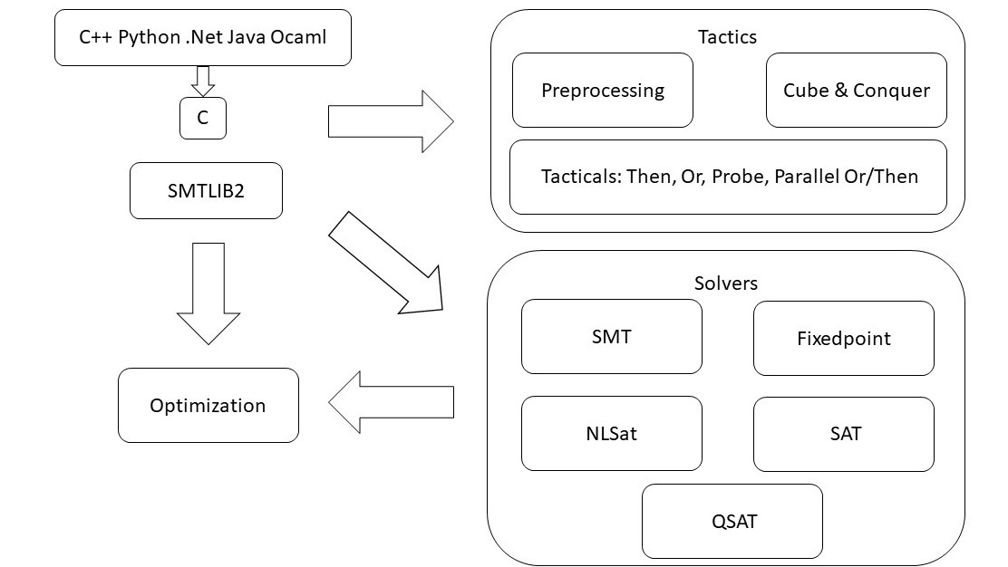
overview

Slide 60
CDCL(T)
Theory
Solvers
SMT
SAT
Equality + UF
Arithmetic
Bit-vectors
…
Case Analysis

Slide 61
CDCL(T)
x ≥ 0, y = x + 1, (y > 2 ∨ y < 1)
$$α$$
$$p1, p2, (p3  p4)$$
Strengthen
($¬p_{1}∨¬p_{2}∨¬p_{4})$
SAT
Block
$$p1, p2, ➢p3, p4$$
$$p1, p2, p4$$
$$γ$$
$$α$$
Theory Conflict
x ≥ 0, y = x + 1, y ≤ 1, y < 1
x ≥ 0, y = x + 1, y < 1

Slide 62
CDCL(T) – Main State Variables
Search State
$$⟨M;F⟩$$
$$⟨M;F;C⟩$$
Conflict State
F – set of clauses
Split into irredundant and redundant clauses.
Redundant clauses can be garbage collected.
2 literal watch list and binary clause optimization
M – a trail of assigned literals
C – a conflict clause

Slide 63
CDCL(T) - Invariants
M
F
$$C$$

Slide 64
CDCL(T) – Dual Model/Proof search
Backjump
Models
literal assignments
Proofs
Conflict Clauses
Conflict Resolution
Propagate

Slide 65
Dichotomy – Proofs and Models
Farkas Lemma
There is an $x$ such that: $Ax=b∧x≥0$
There is a $y$ such that: $yA≥0∧yb<0$
For every matrix $A$, vector $b$ it is the case that
either (1) or (2) holds (and not both).
From DPLL to CDCL
There is $M′⊇M$ such that $M′⊨F$
There is$M′⊆M$ and proof $Π$ such that $F⊢_{Π}\overline{M\text{′} }$
Given $M$ can it be extended to $M$’ to satisfy (1)?
If not, find subset $M′$ to establish (2).
(that is inconsistent with F)
Corollary
Conflict learning (resolution)
extends F by clauses that block shorter models
If $M ⊨¬F$ then
- $\overline{C,ℓ }⊆M$ for some $F⊢C∨ℓ$ (or $F$ contains $∅$)
- for every $D$, where
- $\overline{D},\overline{C} ⊆M^{′}⊆M$,
- $M^{′}⊢(D∨¬ℓ)$
it is not possible to extend${ M}^{′}$ to satisfy $F$

Slide 66
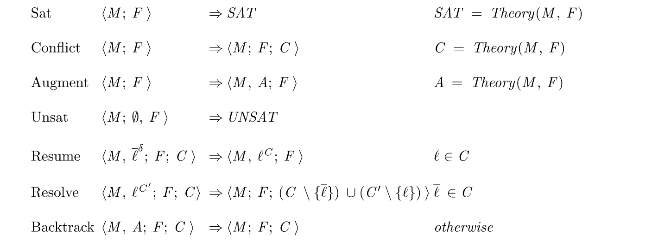
CDCL(T) as inference rules

Slide 67
CDCL(T) – SAT vs SMT
SAT engine
Truth assignment is symmetric for Boolean variables
Probing (for failed literals)
L is failed if asserting L & F infers false by unit propagation.
Cost of propagation controlled by clause watch list
Boolean Variables are fixed during search
“Fast restart” introduced to prioritize variables used in conflicts
SMT engine
Truth values of Booleans are not independent
$x≤0, x≤1$ are dependent
Cost of propagation depends on theories
Quantifier instantiation, theory lemmas introduce fresh literals (all the time)
Fast restarts appears likely not a great idea

Slide 68
CDCL – CaDiCaL loop

Slide 69
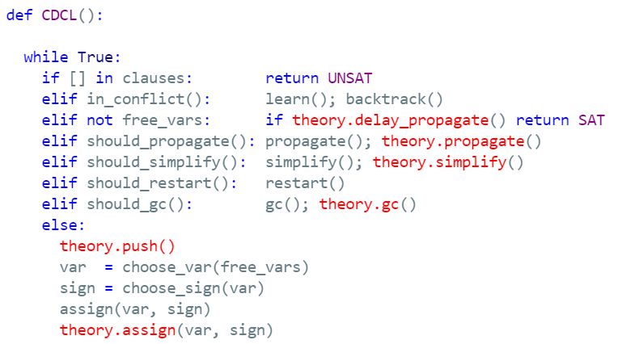
CDCL(T)

Slide 70
Solver Internals

Slide 71
Terms and Formulas
de Bruijn index
Terms are hash-consed
let t = App(f,args) let t’ = termTable[t] mkApp(f, args) = if t’ = nil then termTable[t]$←t$; t else t’

Slide 72
Assertion Internals
(assert (! p :named q))
SMT2 file
assert_and_track(p, q);
API
$$⟨φ=p, π=assume\left(p\right), δ=q⟩$$
Pre-processing simplification
Tactics
Core uses
dependencies
Solver
Transformed Assertions
Proof uses justifications

Slide 73
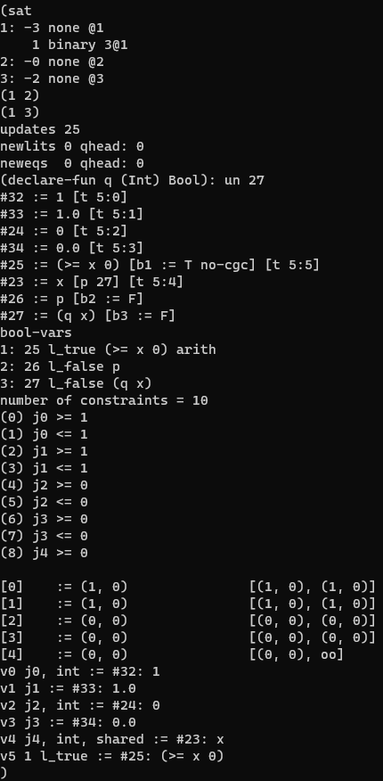
From Assertions to Solver State
$$x≥0 ∨ (p∧q\left(x\right))$$
Clauses
$\left(1 2\right) \left(1 3\right)$
$1↦x≥0, 2↦p, 3↦q(x)$
$n_{23}:⟨f=x,args=ε,$ $P=\left[n_{27}\right],$ $th=\left[\left(arith, 4\right)\right]⟩$
bool_var2expr
expr2enode
z3 search.smt2 /tr:euf tactic.default_tactic=smt sat.smt=true

Slide 74
Core $↔$ Solver interface
CDCL
EUF Core
Solver
$n_{23}:⟨f=x,args=ε,$ $P=\left[n_{27}\right],$ $th=\left[\left(arith, 4\right)\right]⟩$
$n_{25}:⟨≥, args=ε,$ $$boolVar=1, \\ th=[\left(arith,5\right)]$$
$$assigned\left(ℓ@1\right)$$
$$propagate\left(x≥0@5, Explain\right)$$
Dispatch Theory Solver
$$propagate\left(ℓ, Explain\right)$$
$$propagate\left(n≃n′, Explain\right)$$
Does not participate in congruence closure
Theory variable

Slide 75
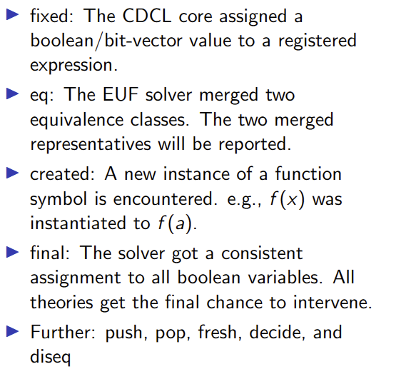
Custom Theories

Slide 76
Model-based Theory Combination
$$x=f\left(z\right), f\left(x\right)≃f\left(y\right), 0≤x≤1, 0≤y≤1, z=y −1$$
$x= ⋆_{1}y= ⋆_{2}z= ⋆_{3}$ $x=1, y=1, z=0$
$f\left(⋆_{1}\right)= ⋆_{1}f\left(⋆_{2}\right)= ⋆_{2}f\left(⋆_{3}\right)=⋆_{1}$
Create fresh literal $x≃y$
Case split on $x≃y←⊤$
Conflict, backtrack $x≠y$
$$x=f\left(z\right), f\left(x\right)≃f\left(y\right), 0≤x≤1, 0≤y≤1, z=y −1,x≠y$$
Create fresh literal $x≃z$
Case split on $x≃z←⊤$
$$x≃z$$
$x=0 y=1, z=0$
$x= ⋆_{1}y= ⋆_{2}z= ⋆_{1}$
$f\left(⋆_{1}\right)= ⋆_{1}f\left(⋆_{2}\right)= ⋆_{2}$

Slide 77
Relevancy Filtering
Purpose: expose only subset of literal assignments to T solvers
Reason: Delays introduction of terms for T-and quantifier instantiation
Idea: Simulate tableau reasoning on top of CDCL
$$(\left(a∧b\right)∨c)$$
$\left(\left(a∧b\right)∨c\right) (¬\left(a∧b\right)∨a)$ $\left(¬\left(a∧b\right)∨b\right)$ $\left(\left(a∧b\right)∨¬a∨¬b\right)$
Root clause
Definition clauses
Scenario 1: c is assigned to T, root clause is satisfied. Atoms $\left(a∧b\right), a, b$ are never set relevant
Scenario 2: c is assigned to F, $\left(a∧b\right)$ is assigned T. Atoms $a, b$ are marked relevant (and propagated to T)
smt.relevancy={0,1,2} (least to most use of relevancy filter)

Slide 78
Ackermann reductions
smt.dack.threshold = 10, smt.dack.eq = false

Slide 79
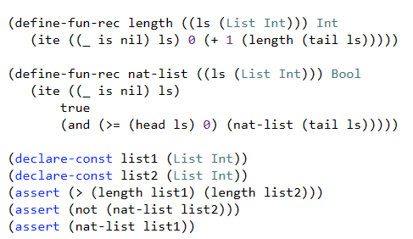
Iterative Deepening
Assume ((_ is nil) list1) ((_ is nil) list2)
Unsat core: ((_ is nil) list1)
Assume ((_ is nil) (tail list1)) ((_ is nil) list2)
Unsat core: ((_ is nil) list2)
Assume ((_ is nil) (tail list1)) ((_ is nil) (tail list2))
Unsat core: ((_ is nil) (tail list1))
Assume ((_ is nil) (tail (tail list1))) ((_ is nil) (tail list2))
SAT

Slide 80
Core Decision Procedures

Slide 81
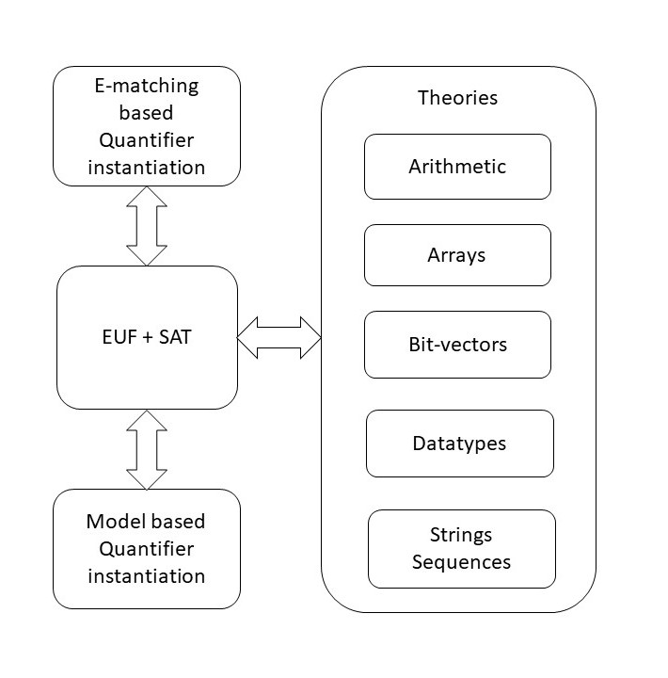
overview

Slide 82
CDCL(T)

Slide 83
Custom Theories

Slide 84
Classification
Arrays
Finite Domains
ADTs
EUF
Arithmetic
Hybrid
str.len, bv2nat
User-Propagator

Slide 85
Finite Domain Theories

Slide 86
Finite Domains and CDCL(T)
Compile to SAT Compile to SAT + E Word level

Slide 87
Finite Domains and CDCL(T)
$$p+q+r≤1∧ \\ (u⇒(p∧q)+(p∨q)+r≥2)$$
Compile to CDCL
Compile to CDCL + PB propagation

Slide 88
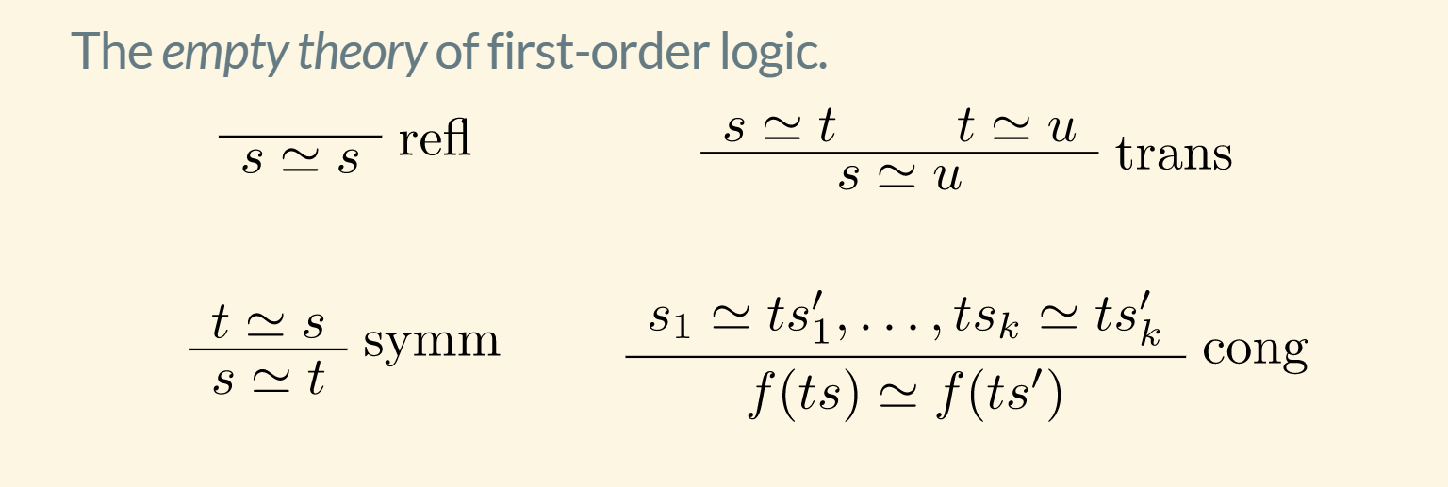
EUF

Slide 89
EUF
$$a = f(f(a)), a = f(f(f(a))), a  f(a)$$
Produce Proofs
Incremental Updates
Propagate Literals
$a =v_{2}, a =v_{3}, a  v_{1},$
$v_{1}≡f\left(a\right), v_{2}≡f\left(v_{1}\right), v_{3}≡f(v_{2})$
$a, v_{2}, v_{3}$
$$v_{1}$$
Union Find
Step 1: Equivalence classes from equalities
$a, v_{2}, v_{3}, v_{1}$
Step 2: Apply Congruence Rule:
$a≃v_{2}$ implies $f\left(a\right)≃f\left(v_{2}\right):{ v}_{1}≃v_{3}$
E-graph

Slide 90
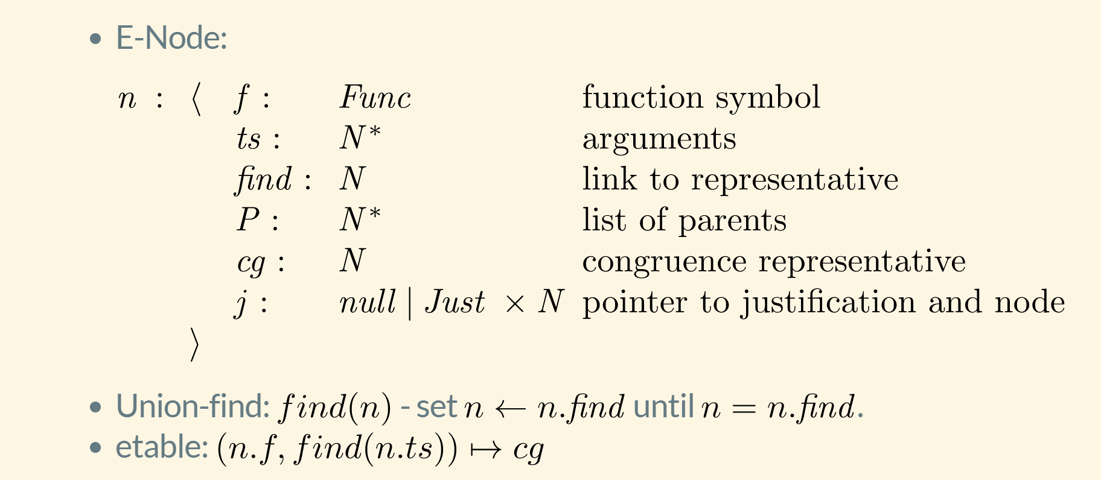
EUF – data-structure

Slide 91
EUF – union-find w. path compression, siblings
Z3 uses path compression to ensure roots are within a single hop of find
Maintain separate singly linked cyclic list of siblings
$$a≃f(c)$$
$$b≃c$$
$$c≃f(c)$$
a
a
b
b
$$b≃c$$
$$a≃f(c)$$
f(b)
f(b)
f(c)
f(c)
c
c
$$cc:f(b)≃f(c)$$

Slide 92
EUF - internalize
$$f(g\left(a\right), g\left(a\right), a)$$
Terms are “hash-consed”
Roots are initialized to self
etable: $[a↦n_{1},g\left(\left[n_{1}\right]\right)↦n_{2}, f\left(\left[n_{2},n_{2},n_{1}\right]\right)↦n_{3}]$

Slide 93
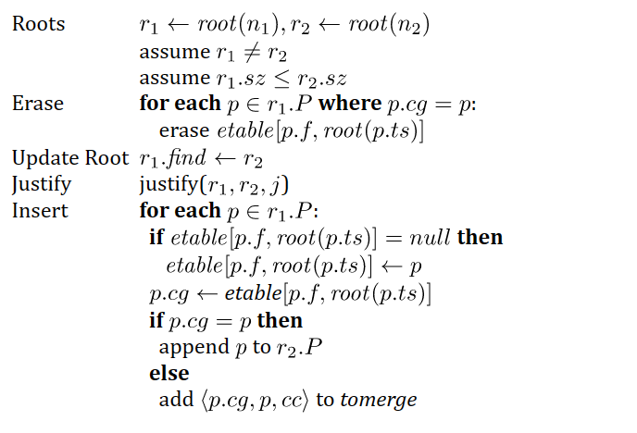
EUF - merge
$$a = f(f(a)), a = f(f(f(a))), a  f(a)$$
$$n_{2}: f(a)$$
$$n_{3}: ff(a)$$
$$n_{4}: fff(a)$$
$$n_{1}:a$$
$${merge(n}_{1},n_{3})$$
$etable\left[f,n_{1}\right]←null$ (since $n_{2}∈n_{1}.P)$
$$n_{1}.find←n_{3}$$
$$n_{2}: f(a)$$
$$n_{3}: ff(a)$$
$$n_{4}: fff(a)$$
$$n_{1}:a$$
($n_{2}∈n_{1}.P)$
$n_{2}.cg←etable[f, {root(n}_{1})]=$ $n_{4}$
$add \left\langle n_{2},n_{4}\right\rangle$ to tomerge

Slide 94
EUF - Justifications
a
b
Union – find link
$$a≃f(c)$$
$$b≃c$$
Justification link
f(b)
f(c)
c
$$cc:f(b)≃f(c)$$
a
After merge
$$c≃f(c)$$
b
$$a≃f(c)$$
$root\left(c\right)←root(f\left(c\right))$
Justification path from
old root(c) to c got reversed
$$b≃c$$
f(b)
f(c)
$$cc:f(b)≃f(c)$$
c
$$c≃f(c)$$

Slide 95
EUF - internals
Nodes from Boolean literals contain fields:
value : { true, false, undef}
boolVar : a number referring to Boolean variable as known by SAT solver
Equality nodes are special: When n1, n2 are merged, the parent n5 is equality, value = false -> conflict
$$a  f(a)$$
$n_{5}=⟨≃, [n_{1},n_{2}], \left(n_{5},n_{5},1\right), P=ε, cg=n_{5},j=nil, value=false, boolVar=27⟩$

Slide 96
EUF – internals: equalities and values
Values: If a node comes from a term that denotes a value (5, 42, 2/3, cons(1,nil)), it is always a root
When two roots with terms based on different values are merged -> conflict
Who reasons about equalities of Booleans? EUF vs. CDCL
E-nodes based on Bool do by default not merge with other nodes.
Default is overridden if E-node occurs under a non-connective.
E-graph propagates equalities to theories and Booleans to SAT
$n_{5}=\left\langle ≃, \left[n_{1},n_{2}\right], \left(n_{5},n_{5},1\right), P=ε, cg=n_{5},j=nil, value=undef, boolVar=27\right\rangle$
$n_{1}.find←n_{2}$ -> value is set to true and assignment to boolVar 27 is propagated to CDCL core

Slide 97
Quantifiers

Slide 98
E-Matching
$$\begin{matrix} & (∀x f\left(g\left(c,x\right)\right)=x\text{)} \\ ∧ & a=g\left(b,b\right) \\ ∧ & b=c \\ ∧ & f\left(a\right)≠c \\ ∧ & \left(∀x f\left(g\left(c,x\right)\right)=x\right)→f\left(g\left(b,b\right)\right)=b\end{matrix}$$
$\begin{matrix} & p_{(∀…\text{)}} \\ ∧ & a=g\left(b,b\right) \\ ∧ & b=c \\ ∧ & f\left(a\right)≠c \\ ∧ & p_{(∀x\text{ ...)}}→f\left(g\left(c,b\right)\right)=b\end{matrix}$
$g\left(c,x\right)$ matches $g\left(b,b\right)$ with substitution $\left[x↦b\right]$ modulo $b=c$
[de Moura, B. CADE 2007]

Slide 99
E-Matching
Match $g\left(c,x\right)$
Match $c$ $root\left(b\right)= c$
Match $x$ $x↦b$
$\begin{matrix} & p_{(∀…\text{)}} \\ ∧ & a=g\left(b,b\right) \\ ∧ & b=c \\ ∧ & f\left(a\right)≠c \\ ∧ & p_{(∀x\text{ ...)}}→f\left(g\left(c,b\right)\right)=b\end{matrix}$
$$c$$
$$g(b,b)$$
$$b$$
$$a$$
$$g(b,b)$$
$$b$$
$$b$$

Slide 100
E-Matching
Match $g\left(c,x\right)$
Match $c$ $root\left(b\right)= c$
Match $x$ $x↦b$
Match $x$ $x↦d$
$$c$$
$$g(b,b)$$
$$g(b,d)$$
$$b$$
$$a$$
$$g(b,b)$$
$$g(b,d)$$
$$b$$
$$b$$
$$d$$

Slide 101
E-Matching
Match $g\left(c,x\right)$
Match $c$ $root\left(b\right)= c$
Match $x$ $x↦b$
Match $c$ $fail$
$$c$$
$$g(b,b)$$
$$g(d,b)$$
$$b$$
$$a$$
$$g(b,b)$$
$$g(d,b)$$
$$b$$
$$b$$
$$d$$

Slide 102
E-Matching
Matching against an E-graph is
Not unitary (more than one match)
Is NP hard $t≃¬f, f≃¬t, t≃t∧t, t≃t∨f, t≃f∨t, t≃t∨t$ $t≃\left(X∨¬Y∨Z\right)∧\left(Z∨¬X∨U\right)∧…$
Minimize incremental work after a new merge
Reuse work when processing multiple patterns
Partial evaluation and run-time code specialization

Slide 103
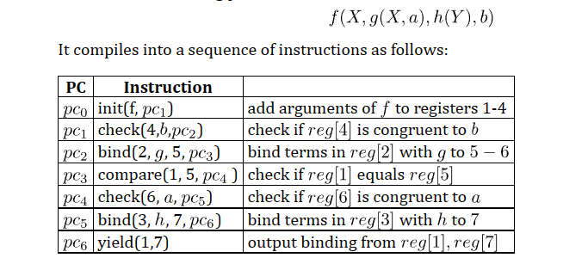
E-Matching using code-trees

Slide 104
E-Matching priorities
$$∀xψ$$
$$x↦g(b)$$
w$=3$
∀𝑥𝜓
𝑥↦𝑔(𝑏)
w=3
$$∀xφ$$
$$x↦g(h(c))$$
$$W=1, \\ gen=2$$
∀𝑥𝜑
𝑥↦𝑔(ℎ(𝑐))
𝑊=1, 𝑔𝑒𝑛=2
$$∀xθ$$
$$x↦h(c)$$
$$W=1$$
∀𝑥𝜃
𝑥↦ℎ(𝑐)
𝑊=1
$$∀xφ \\ x↦h\left(c\right) \\ weight=1 \\ generation=1$$
∀𝑥𝜑 𝑥↦ℎ(𝑐) 𝑤𝑒𝑖𝑔ℎ𝑡=1 𝑔𝑒𝑛𝑒𝑟𝑎𝑡𝑖𝑜𝑛=1
Quantifiers with instances are inserted into a heap
score := (+ weight generation)
weight: annotation on quantifier
generation: number of instantiations used to produce binding
Heap is consumed
During propagation if: score $≤\text{smt}\text{.}\text{qi}\text{.}\text{eager}\text{_}\text{threshold}$
Otherwise at final check if: score $≤\text{smt}\text{.}\text{qi}\text{.}\text{lazy}\text{_}\text{threshold}$

Slide 105
MBQI: Model based Quantifier Instantiation
[de Moura, Ge. CAV 2008]
[Bonacina, Lynch, de Moura CADE 2009]
[de Moura, B. IJCAR 2010]

Slide 106
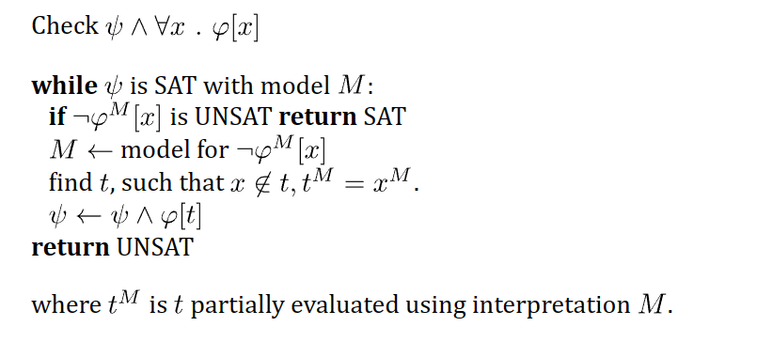
MBQI – outline of approach

Slide 107
Quantifier Elimination / Satisfiability
Presburger Arithmetic, Algebraic Data-types,
Quadratic polynomials
SMT integration to prune branches
[B. CADE 2010, B. Janota LPAR 2015]

Slide 108
QSAT
$$F_{j−1}←F_{j−1}∧∃{x_{j}(F}_{j }∧ x_{≤j} = M(x_{≤j}))$$
$Q_{j−1}$
find model for $F_{j}∧ x_{≤j−1 } = M(x_{≤j−1})$
$Q_{j}$
unsat
fix $x_{j} = M(x_{j})$
sat
find model for $F_{j+1 }∧ x_{≤j} = M(x_{≤j})$
$$Q_{j+1}$$

Slide 109
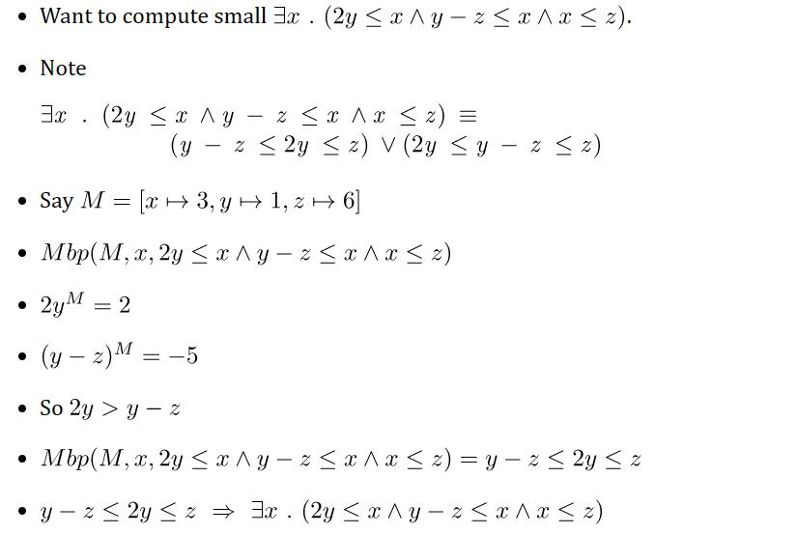
MBP

Slide 110
MBP – model-based projection
$(M\left(y\right)=y)⇒Projection⇒∃x…$:
Finite set of projections for $∃x…$
Dual projection $∀x…$ used to close case splits during search
Model is used for free variables (value of x is not needed in procedures)

Slide 111
MBP – theories
LRA, LIA, NRA
Term algebras (disunification)
Some cases with arrays
Bit-vectors (z3 currently bit-blasts)

Slide 113
Theory Solvers

Slide 114
Arithmetic
SAT/SMT Backtracking
Search
Propagation
+ Conflicts
Assert bounds on integer/real variables
Solve for Reals Use Simplex to find solutions to constraints + bounds
Bounds propagation Infer equalities and bounds from existing bounds
Solve for Integers
Cube
GCD test
Branch and Bound
Hermite Normalize
Gomory Cuts
Solve for multiplications
Bounds propagation
Horner expansion
Gröbner solving
Incremental linearization
NL-SAT
SAT

Slide 115
Arithmetic – Linear Programming
Input formula
Bounds added during search
$$x≥0, s_{1}≤2, s_{1}≥2$$
Internal representation
$s_{1}≡x+y, s_{2}≡x+2y$
$$x≥0, \left(s_{1}≤2∨s_{2}≥6\right), \left(s_{1}≥2∨s_{2}>4\right)$$
Pivot and change values to satisfy bounds
$$y=s_{1}−x, s_{2}=−x+2s_{1}$$
$s_{1}=2, y=2, x=0, s_{2}=4$
Initial tableau and values
$$s_{1}=x+y, s_{2}=x+2y$$
$$s_{1}=x=y=s_{2}=0$$

Slide 116
Propagating Equalities
SAT/SMT Backtracking
Search
$$x=z$$
$$x+1=y$$
Assert bounds on integer/real variables
$$y −1=z$$
Complete method [Bromberger & Weidenbach]:
1. Turn $≥$ into $>$ on asserted bounds.
2. If new inequalities are infeasible, then $≥$ can be strengthened to $=$ in minimal unsat core.
Bounds propagation Infer equalities and bounds from existing bounds
$$\underline{x+1=y y −1=z}$$
$$x=z$$

Slide 117
Propagating Equalities
Equality inferences require addition/subtraction operations
Asserted inequalities
$x+u≤z z −1≤y y≤x 1≤u≤1$
$$\underline{x+1=z z −1=y}$$
$$x=y$$
How the solver sees the constraints
$x+u+s_{1}=z z −1+s_{2}=y y+s_{3}=x 1≤u≤1 0≤s_{1} 0≤s_{2} 0≤s_{3}$
After pivoting
$$x=z−u −s_{1} y=z −1+s_{2} s_{3}={−s}_{2}− {u+1− s}_{1} 1≤u≤1 0≤s_{1} 0≤s_{2} 0≤s_{3}$$
After propagating bounds on $s_{1}, s_{2},s_{3}$
$$x=z−u −s_{1} y=z −1+s_{2} s_{3}={−s}_{2}− {u+1− s}_{1} 1≤u≤1 0≤s_{1}≤0 0≤s_{2}≤0 0≤s_{3}≤0$$
Subtract first two equalities to infer
$$x=y$$
Subtle complexity: Every row can have many fixed variables. Adding values of constant bounds requires significant runtime.

Slide 118
Propagating Equalities - efficiently
$$\underline{x=z−u −s_{1} y=z −1+s_{2} 1≤u≤1 0≤s_{1}≤0 0≤s_{2}≤0 0≤s_{3}≤0}$$
$$x=y$$
Instead of adding up rows to prove implied equality
Use fact all variables have values assigned by Simplex solver
Then two variables are equal if
They are connected through offset equalities
They have the same value
offset equality
$$x=y+{\underset{{b_{1}≤z}_{1}≤b_{1}, { b}_{2}≤z_{2}≤b_{2},}{\underbrace{{a_{1}z}_{1}+a_{2}z_{2}+…}}}_{}$$
Example: If solver assigns $x=3$ then $z=4, y=3$
$x, y$ are connected (over $z−1$).
$x, y$ have the same value (3)

Slide 119
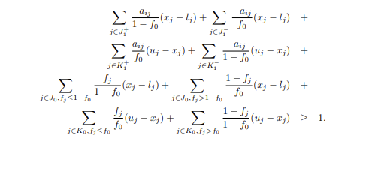
Arithmetic – Integers
Cube
GCD test
Unit Cube fits
$⇒$ Integer solutions are guaranteed
5 + 3y + 6z = 0
Has no integer solution because 3$⊥$ 5
Branch and bound
Cut
$LP solver:x ≔1.5$
Create case split: $x≤1$
Z3 knows : $¬\left(x≤1\right)≡x≥2$
[copied from Duterte, de Moura SRI TR]

Slide 120
Arithmetic – Integers
In scope
Bounds propagation to CDCL
Equality propagation to T
Modeling at level of SMT
Out of scope
Finite domains
Weak cuts
Incomplete for mixed-Integer
Modular arithmetic and LP

Slide 121
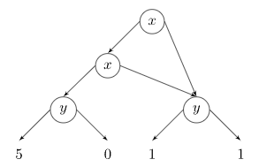
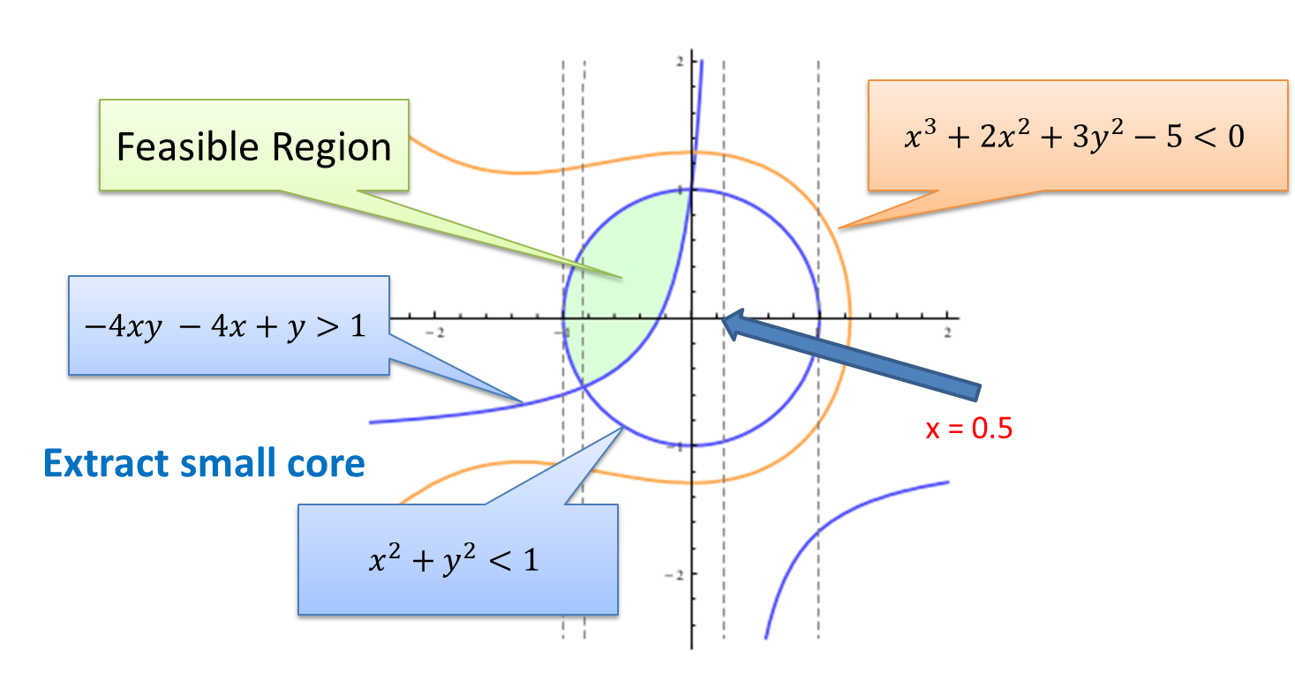
Arithmetic – Non-linear
Non-linear bounds
Gröbner
Factoring and equality propagation
$$xy=0∧xyz+u−v=0⇒u=v$$
Solving (based on variable ordering)
$$x+p=0∧x^{2}q+r=0⇒p^{2}q+r=0$$
Result of GB used for bounds propagation
$$0≥x≥−2∧ 0≤ y≤ 3⇒ x⋅y≥ −6$$
$$0≥x≥−2∧ 0≤ y≤ 3⇒ x⋅x⋅y≤ 12$$
Polynomials as
Multi-terminal ZDDs
Based on implied bounds
Incremental Linearization
NLSAT
$$0≥x≥−2∧ 0≤ y≤ 3⇒ x⋅y≥ −6$$
$$0≥x≥−2∧ 0≤ y≤ 3⇒ x⋅x⋅y≤ 12$$
(how it is staged?)
Based on current values for x, y

Slide 122
Arithmetic – Non-linear
In scope
Bounds and Equality propagation
Polynomials over reals (low degree)
Out of scope
Polynomials over integers
Exponentiation
Trigonometric functions
Indefinite operations
summations/products/integrals

Slide 123
Arrays
Reducible | reduce to base theories
Compile into EUF
UNSAT

Slide 124
Arrays
Reducible | reduce to base theories
Convert EUF solution to
solution over arrays
Compile into EUF

Slide 125
A Solver for Unicode Characters
Unicode Theory
$⟨U, ≤,=:U×U→Bool⟩$ $\left|U\right|=196608$
Operator $≤$ is used sparingly
So common case is theory of $=,≠$
Engine: Union-find + Lazy reduction to bit-vectors
Inferior alternatives: pure bit-vectors, linear arithmetic, difference arithmetic

Slide 126
A Solver for $⟨U, ≤,=:U×U→Bool⟩$ $\left|U\right|=196608$
Equality
Union Find
a
b
c
d
e
s
t
a = b, b = c, d = e, b = s, d = t, a≠ e, a≠ s
a,b,c,s
d,e,t

Slide 127
A Solver for $⟨U, ≤,=:U×U→Bool⟩$ $\left|U\right|=196608$
Equality
Union Find
a
b
c
d
‘e’
s
‘t’
a = b, b = c, d = ‘e’, b = s, d = ‘t’, a≠ e
a,b,c,s
d,’e’,’t’

Slide 128
A Solver for $⟨U, ≤,=:U×U→Bool⟩$ $\left|U\right|=196608$
$$a≤b$$
Inequality
Bit-blasting
$\left(a\left[17\right]→b\left[17\right]\right)$
$∧\left(\begin{aligned}(a\left[17\right]↔b\left[17\right])→ \\ a\left[16:0\right]≤b\left[16:0\right]\end{aligned}\right)$
$$a\left[17:0\right]≤b\left[17:0\right]↔$$
$$⋮$$
$$a\left[0:0\right]≤b\left[0:0\right]↔\left(a\left[0\right]→b\left[0\right]\right)$$

Slide 129
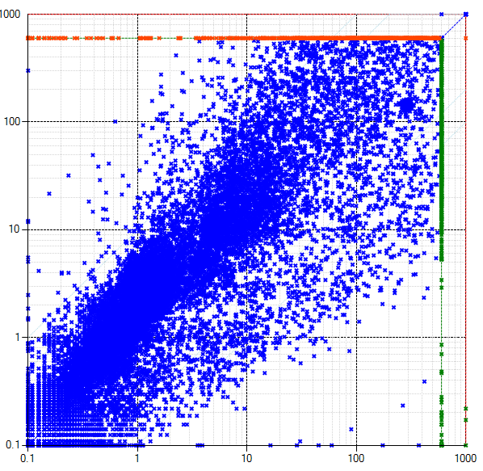
A Solver for $⟨U, ≤,=:U×U→Bool⟩$ $\left|U\right|=196608$
Combining two views
$$a=b$$
$$a≤b$$
Equality View
Bit-Blast View
$$⟨U, ≤,=:U×U→Bool, bv2char :Bool^{18}→U,$$
$$\left[0\right]:U→Bool, \left[1\right]:U→Bool, …, \left[17\right]:U→Bool⟩$$
This solver
$$bv2char\left(a\left[17\right], …, a\left[0\right]\right)=a$$
Bit-vector solver

Slide 130
Custom Theories

Slide 131
Tutorial road-map
Theory Solvers
What to expect when expecting z3?
Quantifiers
Interfacing with z3
Use case
Solver Internals
Tactics
Use case
Solver Engines - CDCL(T)

